Slide 1
Daryolar va Yer osti suvlarining geologik faoliyati. Ulardan hosil bo‘lgan tog‘ jinslari va foydali qazilmalar. Yer usti relefining o‘zgarishi

Slide 2
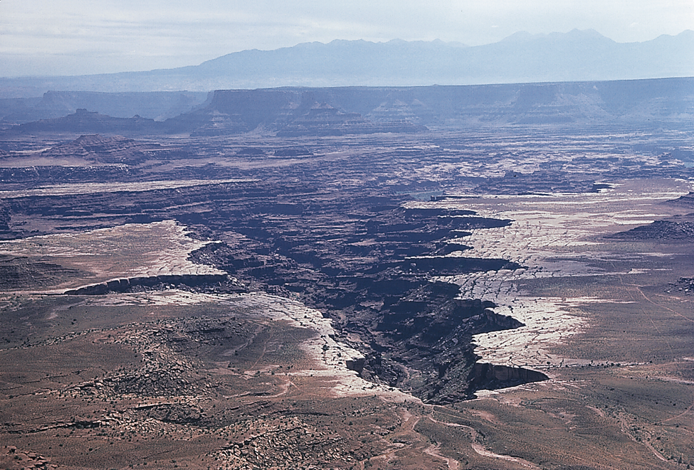
Fig. 17.03 d
Plateau incision by headward erosion…
Stephen Marshak

Slide 3
Reja: Daryolar geologik faoliyati Yer osti suvlarining geologik faoliyati. Ulardan hosil bo‘lgan tog‘ jinslari va foydali qazilmalar. Yer usti relefining o‘zgarishi

Slide 4
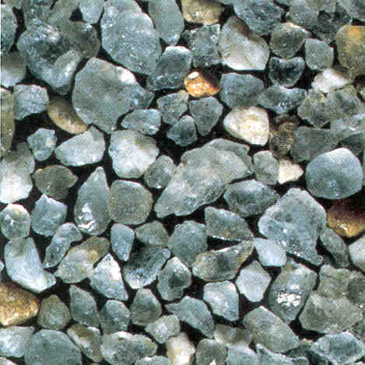
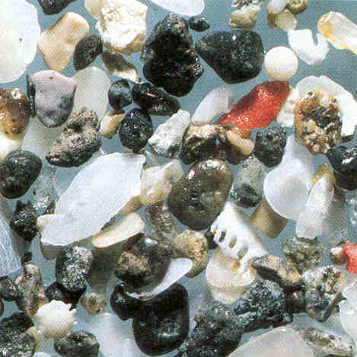
Example:
Well-sorted
Poorly-sorted

Slide 5
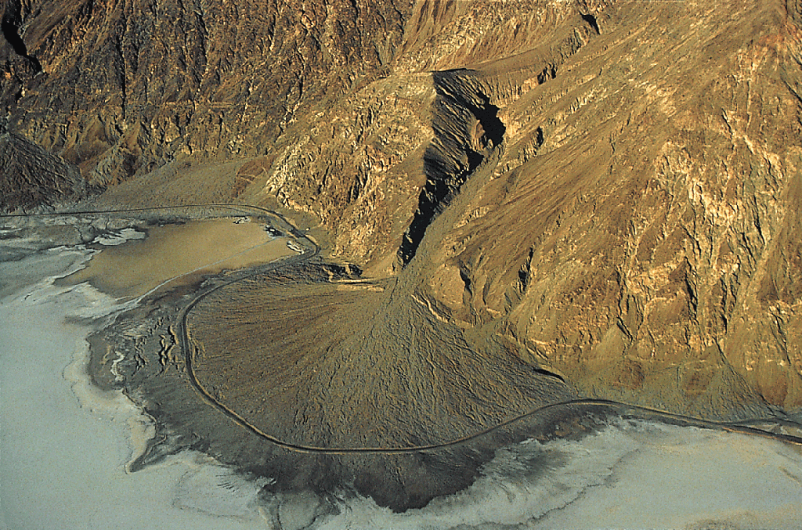
Fig. 7.28c
© Martin Miller

Slide 6
BLIS SAVOL gidrosfera nima? daryo tushunchasi. yer osti suvlar tushunchasi. relef o‘zgarishi sabablari.

Slide 7
Fig. 17.03 d
Plateau incision by headward erosion…
Stephen Marshak

Slide 8
DARYoLARNING GEOLOGIK FAOLIYaTI | Kompleks ekzogen jarayonlar qatog‘ida materiklar yuzasi-ning relefini o‘zgartirishda asosan daryolar katta rol o‘ynay-di. Yer yuzidagi daryolar ham yemiruvchi, buzuvchi, ham yaratuvchilik faoliyatlari bilan ekzogen jarayonlari ichida alohida o‘rinni egallaydi. Daryolarning geologik faoliyati uch xil yo‘l bilan amalga oshadi: 1-tog‘ jinslarini yemirish -- eroziya, 2-suv yorda-mida yemirilgan jins mahsulotlarini bir joydan ikkinchi joyga ko‘chirish —surish, oqizish, eltish va 3-ularni joy-joyiga to‘plab yotqizish — akkumulyatsiya. Lekin daryolarning geologik faoliyati jadalligi, vaqt jihatidan ma’lum joylarda namoyon bo‘lishi daryolarning tarixiy rivojlanish jarayoni bilan belgilanadi. Daryolar bajarayotgan geologik ishining natijasi ulariing kuchi va qudratiga bog‘liq. Daryo suvining kuchi suvning massasiga va uning oqish tezligiga to‘g‘ri proporsionaldir va u quyidagi formula bilan ifodalanadi.

Slide 9
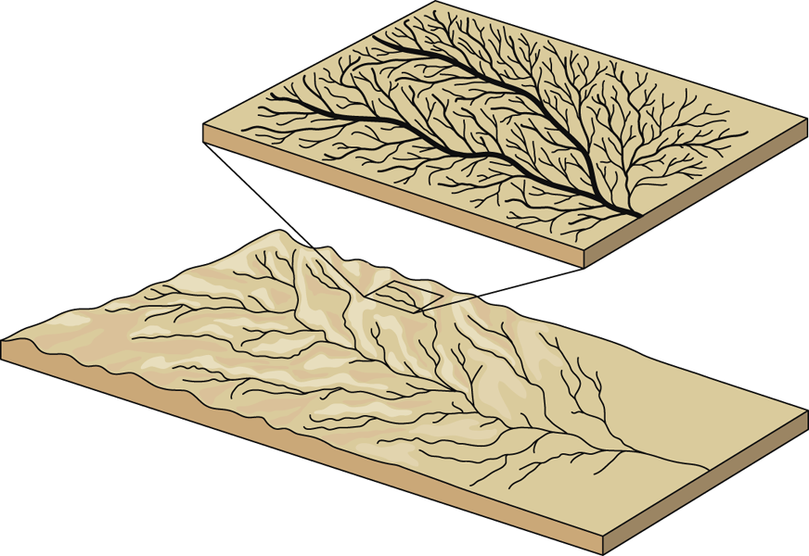
Fig. 17.05 b
W. W. Norton

Slide 10
Eroziya xillari. Oqar suvlar yonbag‘irni pastdan yuqoriga tomon, yonbag‘ir etagidagi eroziya bazisi deb ataluvchi ma’lum nuqtadan boshlab yemiradi. Jar go‘yo orqaga chekinayotganga o‘x-shaydi, buni regressiv eroziya deb ataladi. Daryo yoki boshqa oqin suvlar to‘lib-toshib oqayotganda qirg‘oqlarini buzib kengaytira-di, bunga yon eroziya deyiladi. Chuqurlatish eroziyasi esa daryo sharsharalari ostida, o‘zanining yemirilishi tufayli yuzaga kela-di. Daryo bu qismida ko‘pinchalik kuturib oqadi.

Slide 11
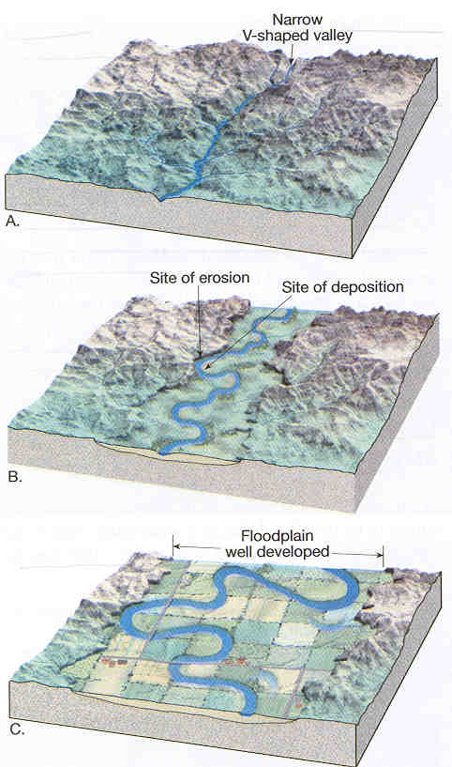
As streams approach
their base level, they
begin to dissipate
their energy by
meandering
from side to side.
Lateral erosion and
channel migration
begin to dominate over
channel downcutting…

Slide 12
Eroziya bazisi. Daryolarning dengiz yuzasiga quyiladigan qis-mi hududini eroziya bazisi deb ataladi. Eroziya bazisi daryo suv-larining geologik ta’sir kuchini yo‘qotib, yemirish, o‘yish kabi harakatlar to‘xtatgan yuzasidir. Dengiz va ko‘l suvlarining sath-lari -- delta qismlari daryolarning eroziya bazisi hisoblana-di. Eroziya bazisi tezda o‘zgarib turadi. Agar ma’lum sabablar-ga ko‘ra suv o‘zapi qiyaligi o‘zgarsa — oqayotgan suvning bosh ta-rafidagi joy ko‘tarilsa yoki dengiz suvining orqaga qaytishi sababli uning sathi pasaysa, u vaqtda eroziya bazisi ham pasayadi va suvning oqish kuchi (tezligi) ortadi — daryoning geologik fao-liyati kuchayadi. Aksincha, qiyalik tekms holatga yaqinlashgan sari, oqayotgan suvning kuchi kamayadi va shunga muvofiq yuvish-yemirilish harakati ham sekinlashib oxiri to‘xtaydi

Slide 13
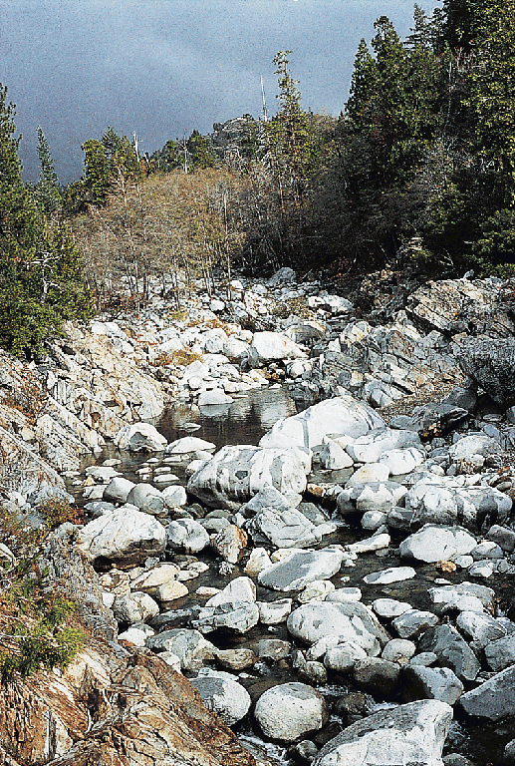

Slide 14
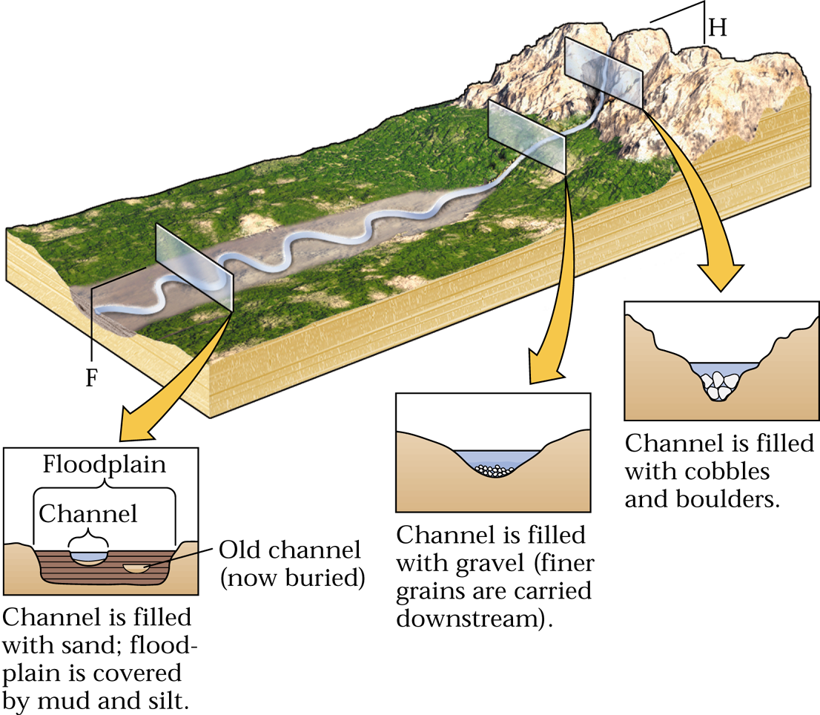
Fig. 7.29b

Slide 15
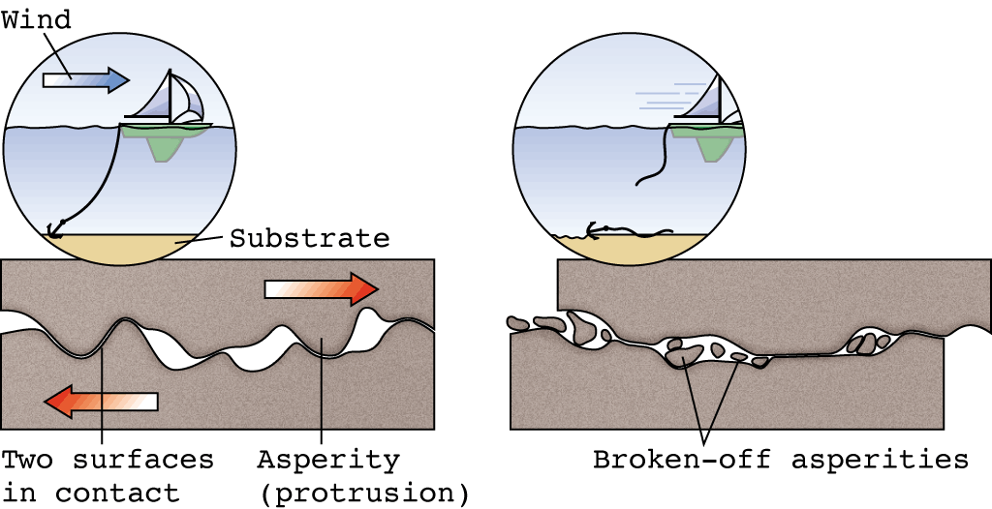
Fig. 10.09
Stress builds up along faults because blocks
are locked together by friction along fault plane.
W. W. Norton

Slide 16
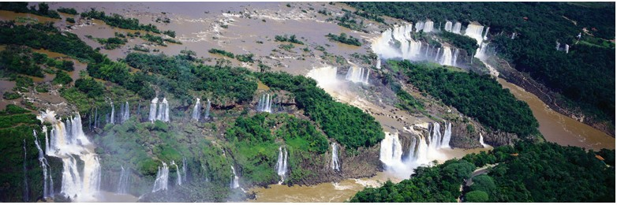

Slide 17
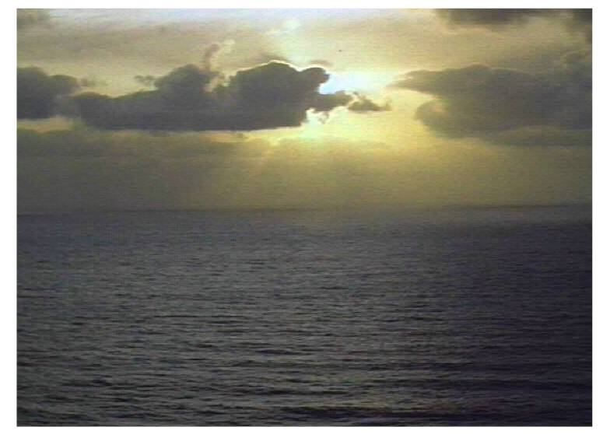
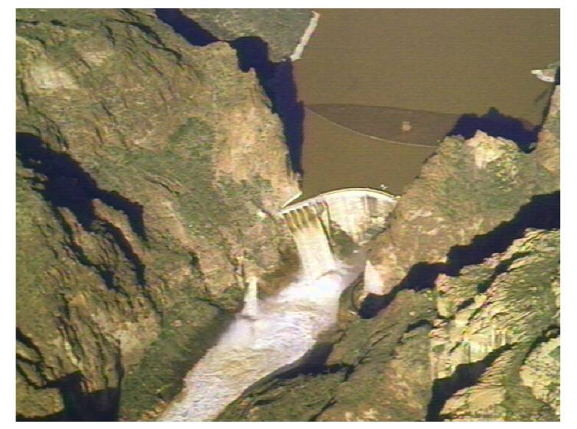
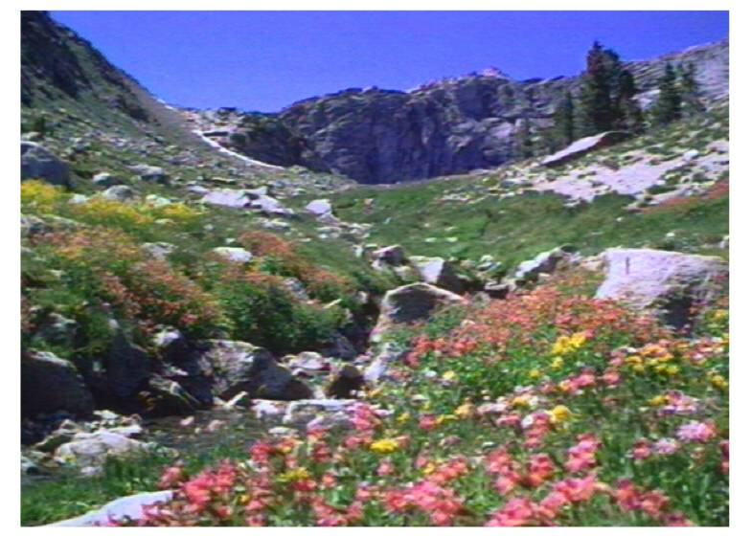
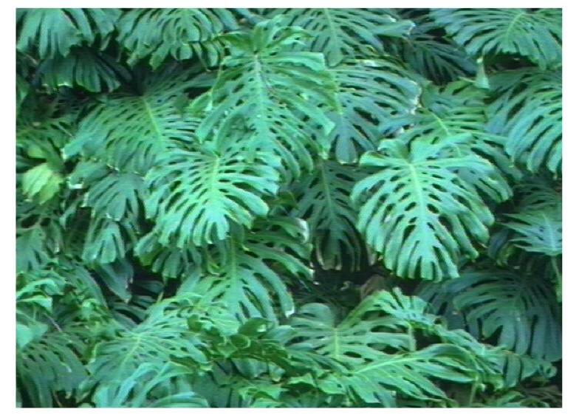
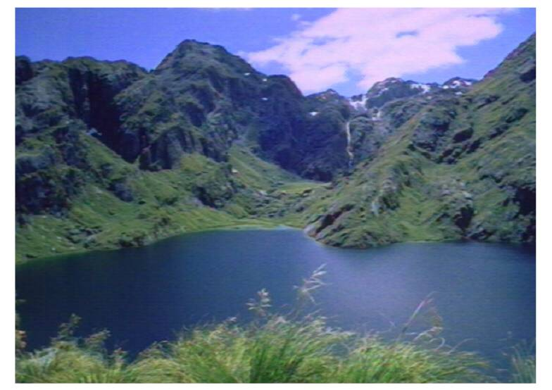
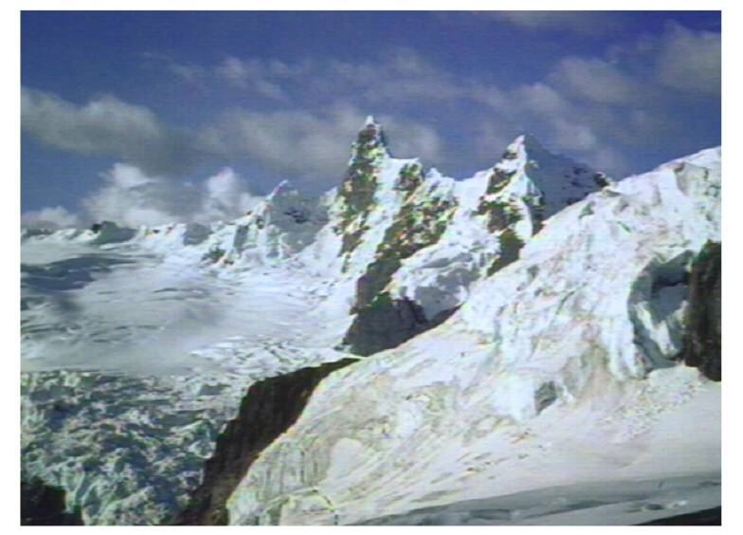
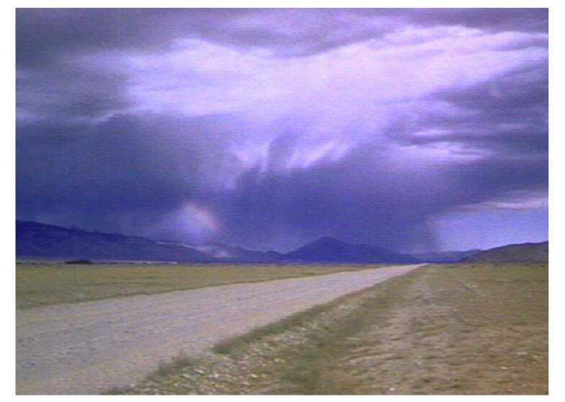
oceans
sediments
& soil
dams
rivers
evaporation
mountains
plants
lakes
snow
rain

Slide 18
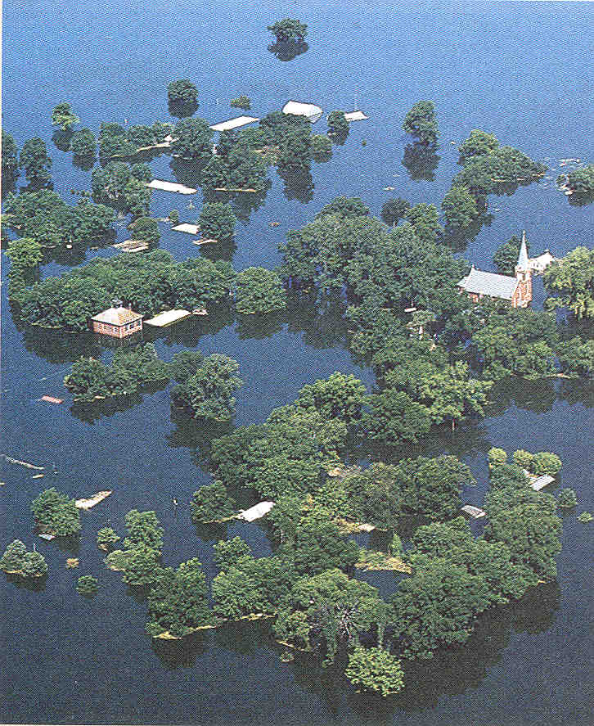
Running Water:
Why care?

Slide 19
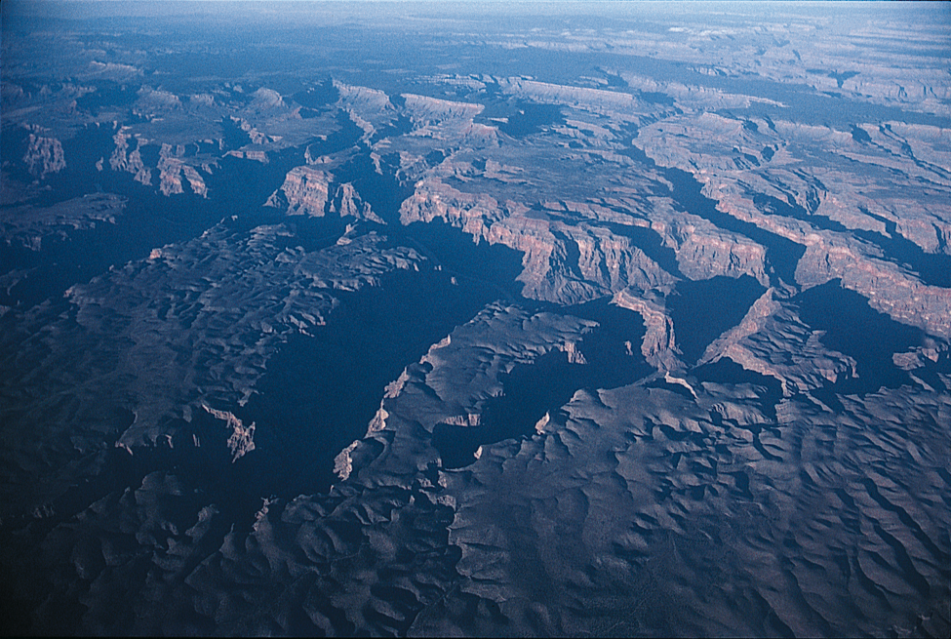
Fig. 17.19
Stephen Marshak

Slide 20
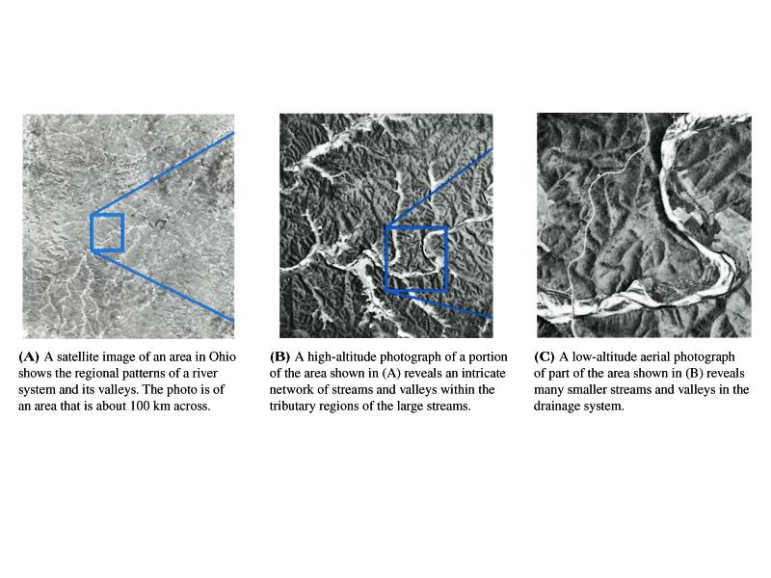

Slide 21
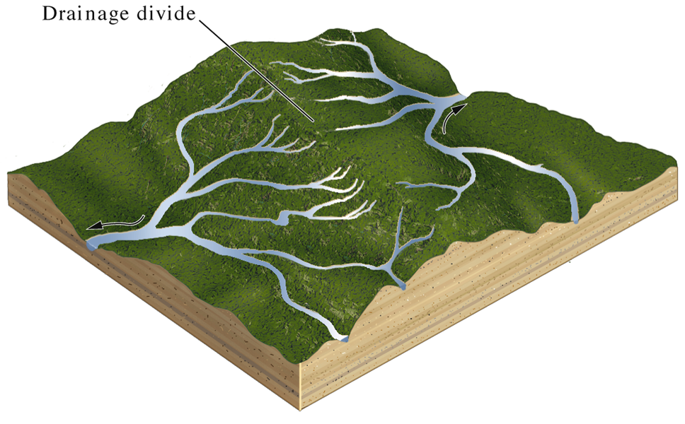
Fig. 17.06
Drainage basins are areas that are drained
by the same stream system…
W. W. Norton
Drainage basins
are separated by
drainage divides,
where streams
on either side flow
opposite directions.

Slide 22
Fig. 17.06
Drainage basins are areas that are drained
by the same stream system…
W. W. Norton
Drainage basins
are separated by
drainage divides,
where streams
on either side flow
opposite directions.

Slide 23
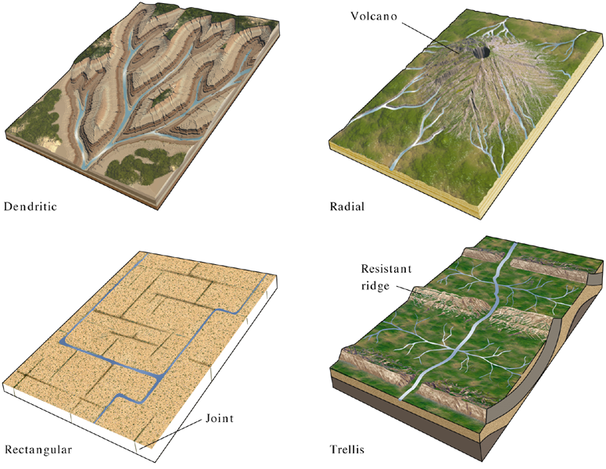
Fig. 17.04abcd
Drainage patterns are strongly controlled
by the structure of the underlying rock units…
W. W. Norton

Slide 24
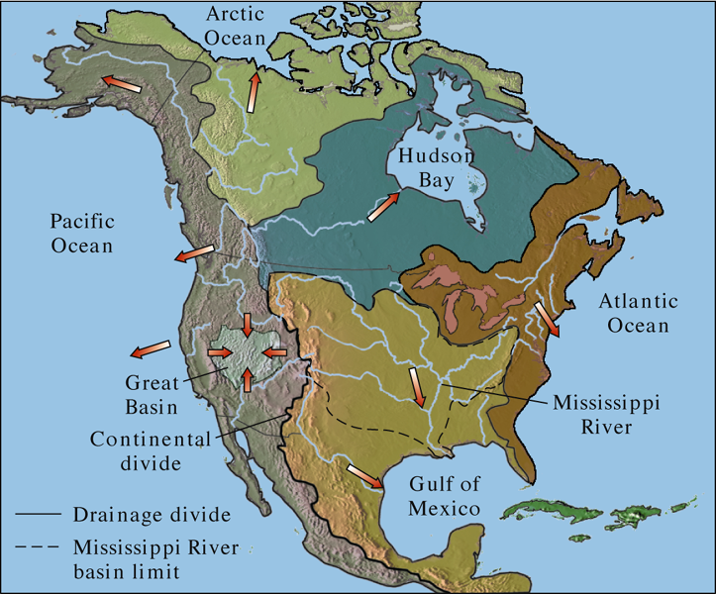
Fig. 17.07
Major Drainage Basins of North America

Slide 25
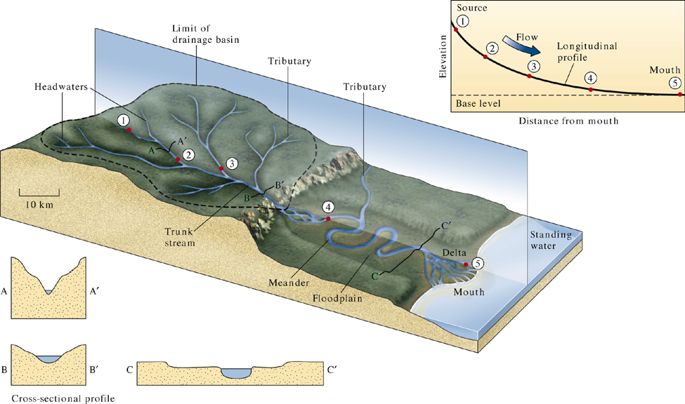
Fig. 17.05 a
Longitudinal stream profile
W. W. Norton
Cross sectional profiles at
different points along
stream course.

Slide 26
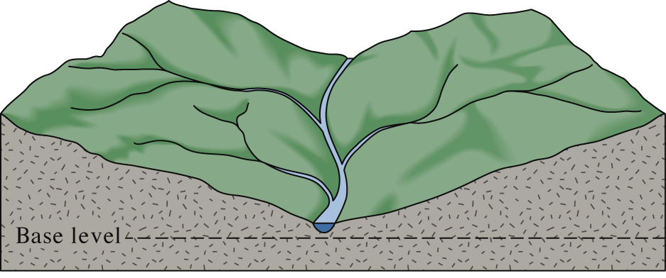
Fig. 17.21 a
W. W. Norton

Slide 27
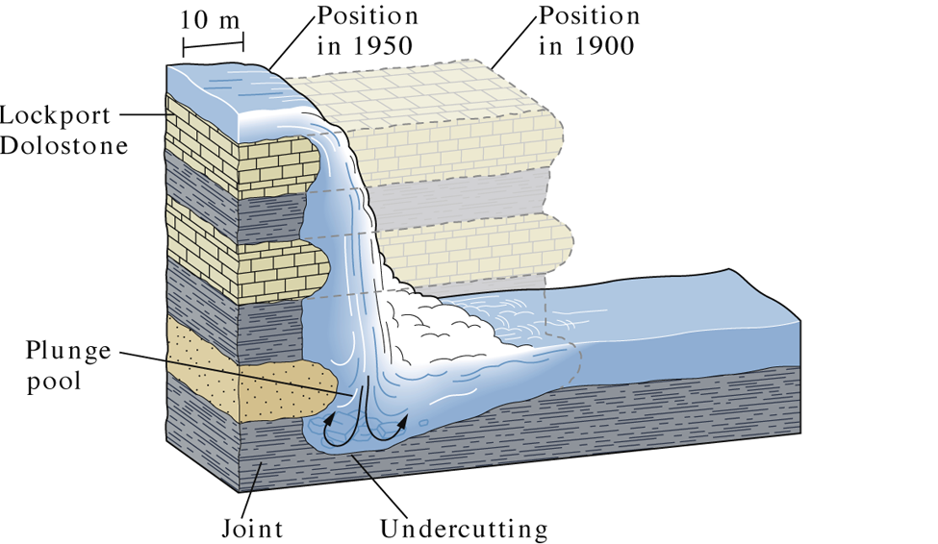
Fig. 17.24 b
Removal of a waterfall is accomplished by undercutting
at the base of the fall and collapse of the channel above…
W. W. Norton

Slide 28
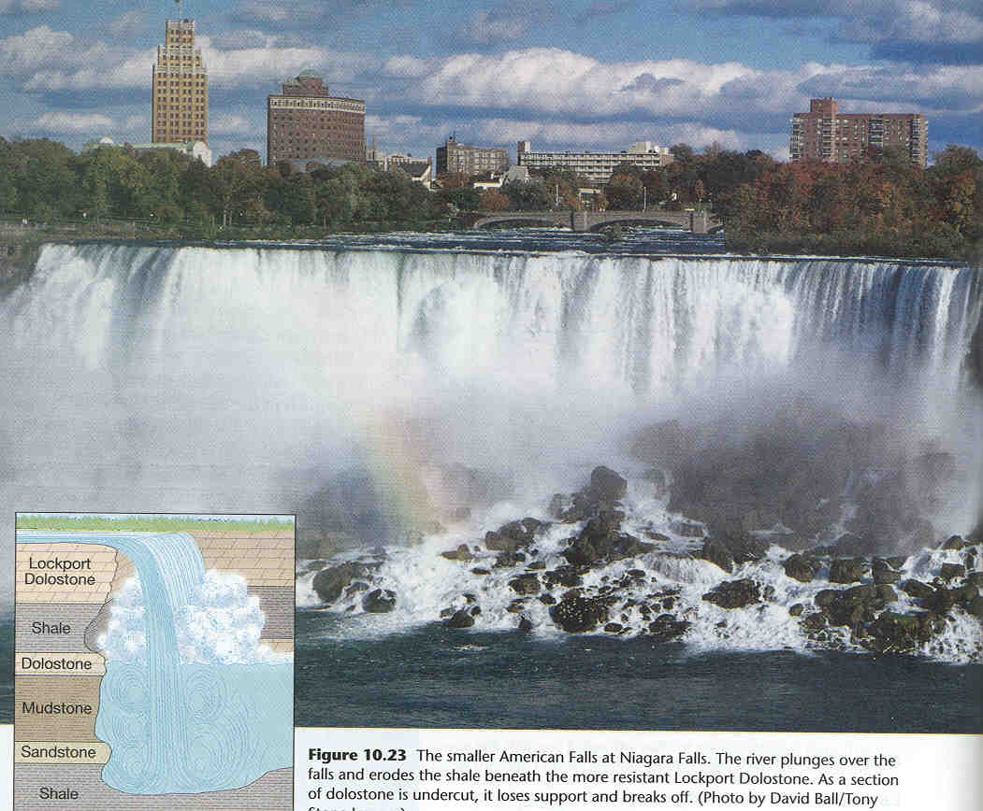

Slide 29
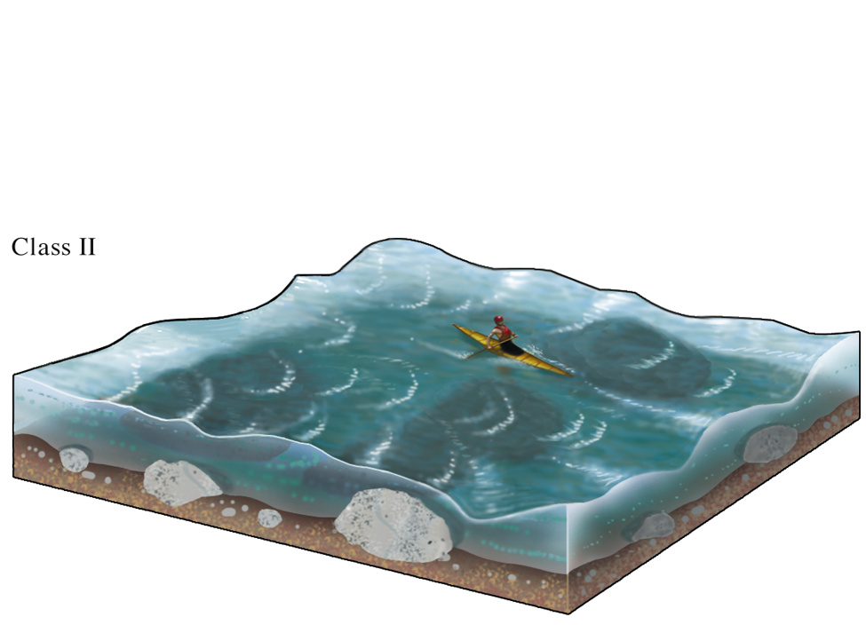
Fig. 17.23 Class II
Rapids…
W. W. Norton

Slide 30
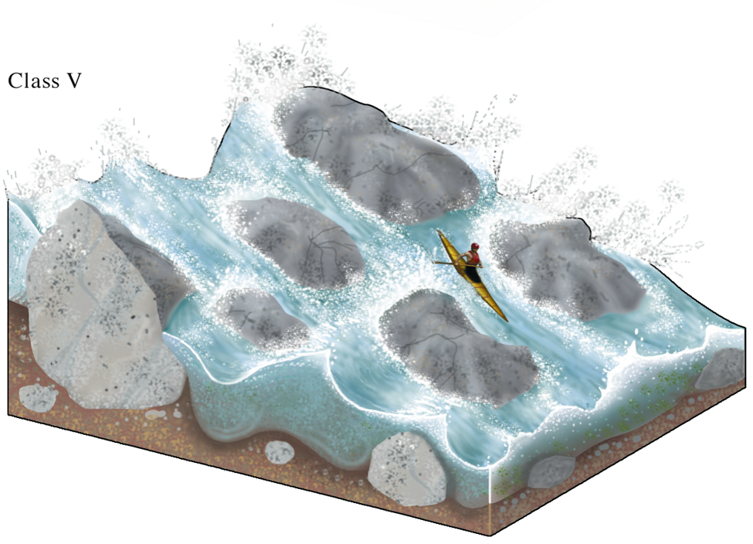
Fig. 17.23 Class V
Extreme Rapids…
W. W. Norton

Slide 31
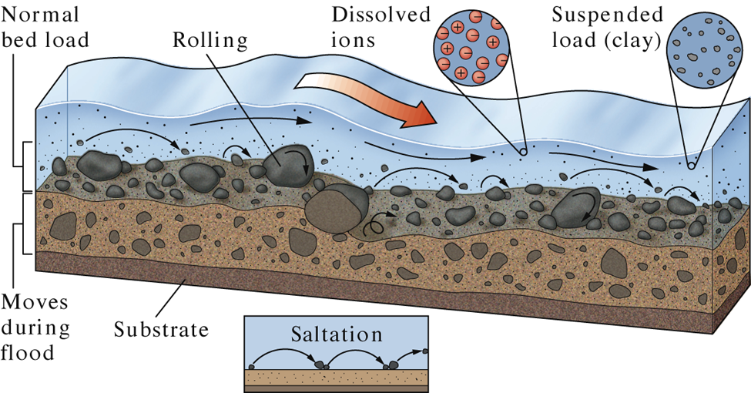
Fig. 17.16 d
Mechanisms of bed load transport: Rolling and saltation.
W. W. Norton

Slide 32
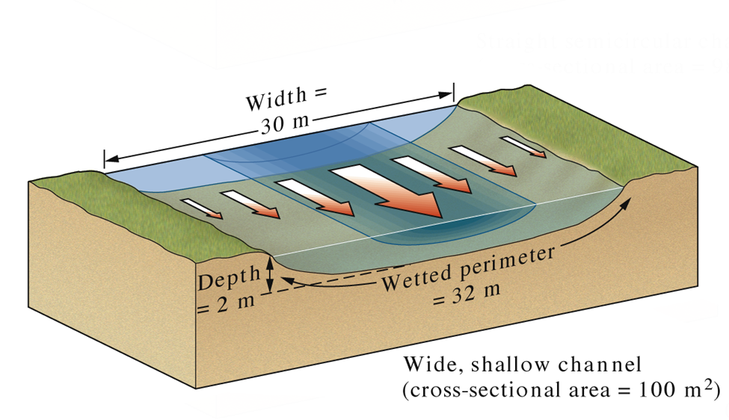
Fig. 17.14 b
Shallow channels with rougher walls
favors lower velocity…
W. W. Norton

Slide 33
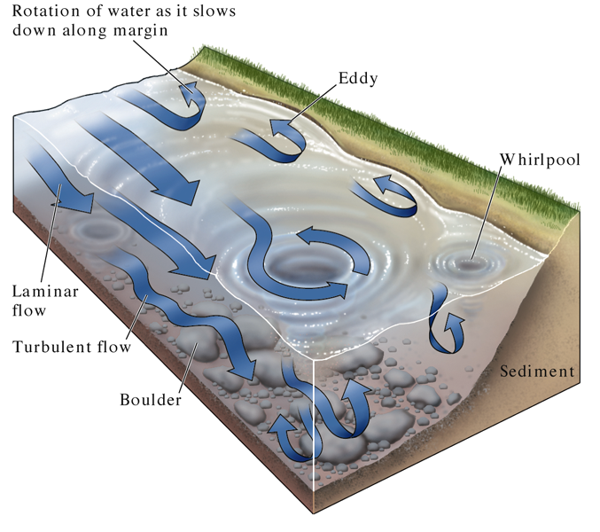
Fig. 17.15
W. W. Norton

Slide 34
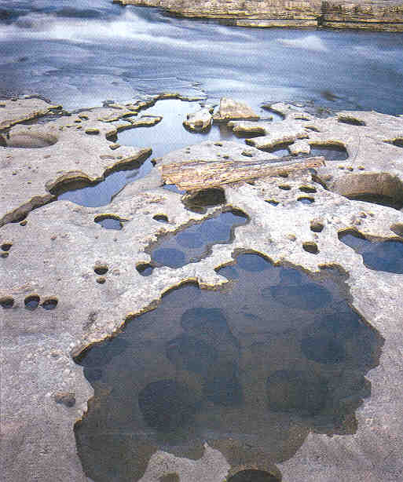
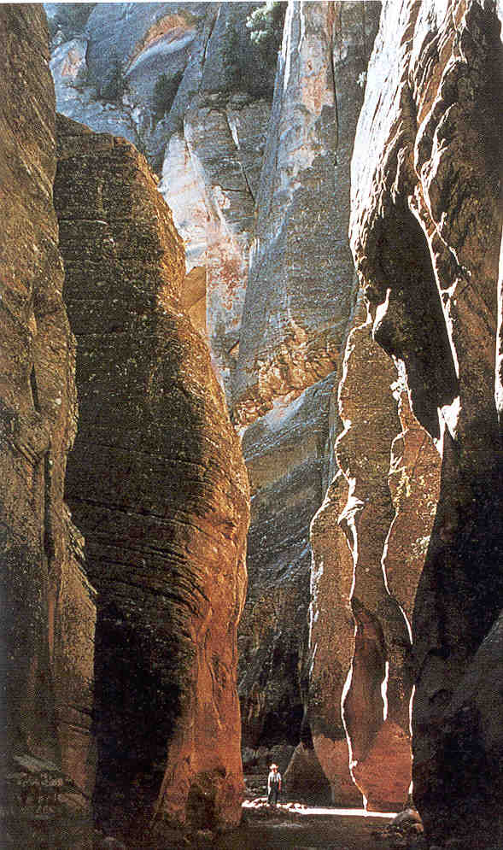
RUNNING
WATER
Stream Erosion: Downcutting
Slotted Canyon
Potholes

Slide 35
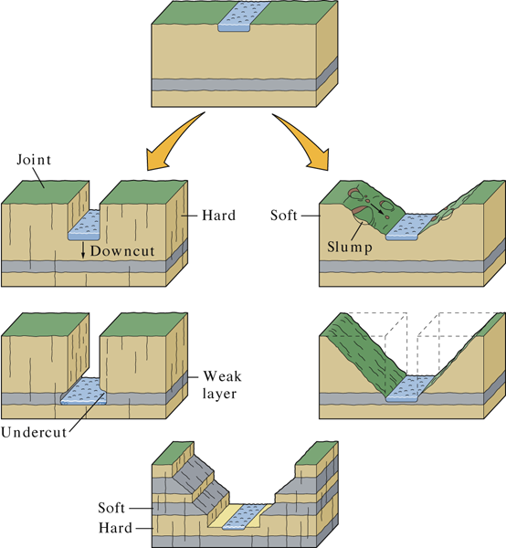
Fig. 17.20 a-c
W. W. Norton

Slide 36
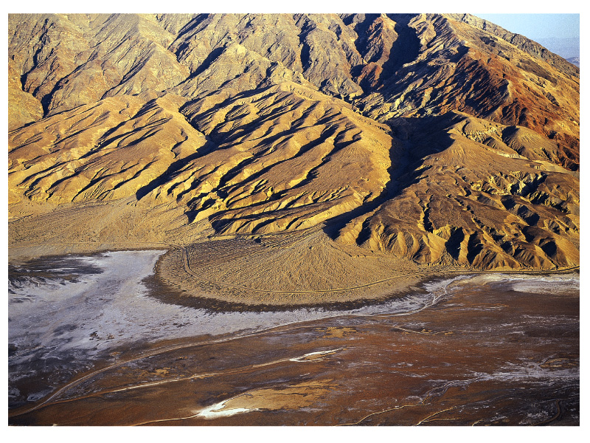

Slide 37
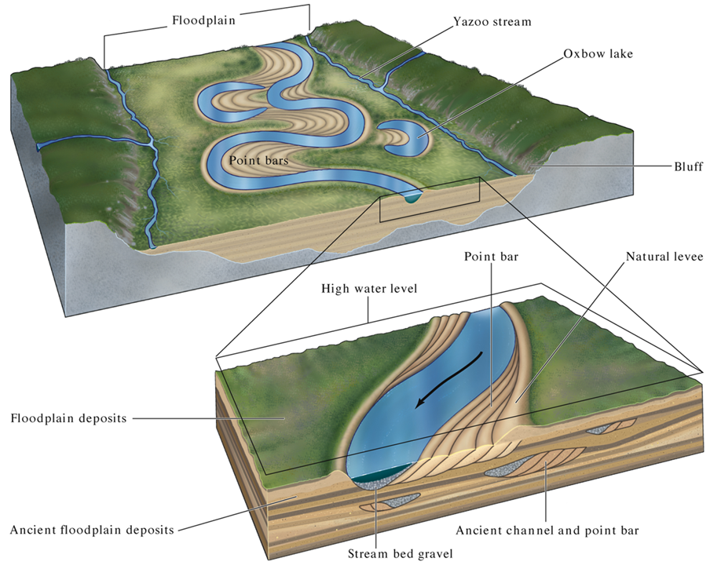
Fig. 17.26 c
W. W. Norton

Slide 38
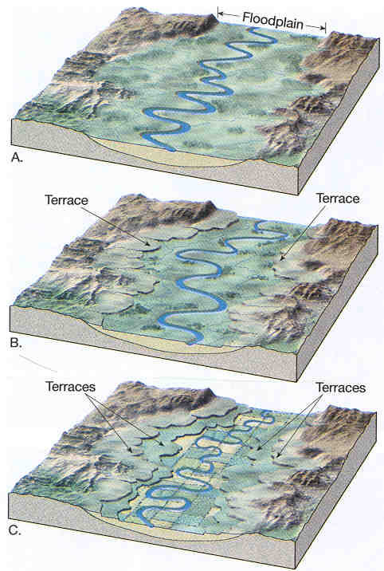
Floodplains
and terraces…

Slide 39
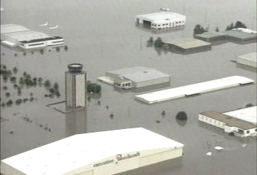
Where not to build: River floodplains…

Slide 40
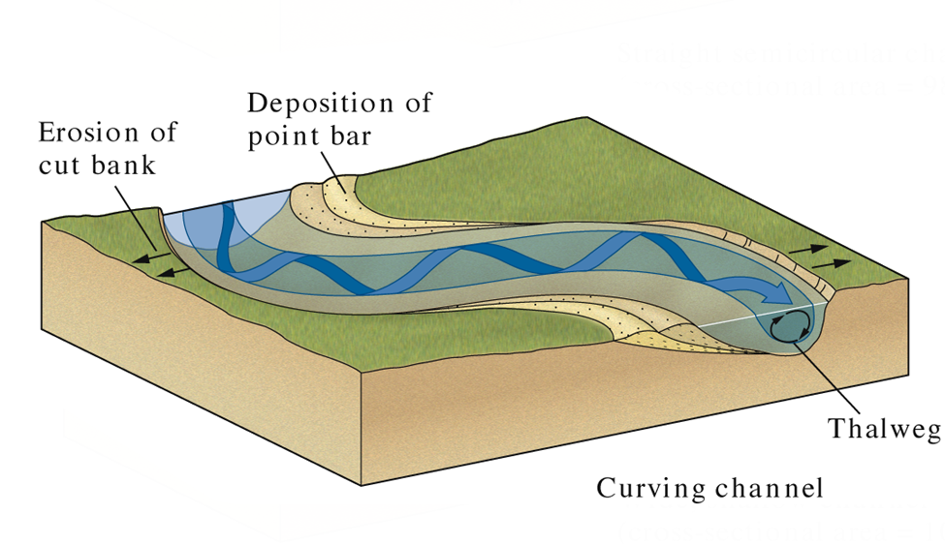
Fig. 17.14 c
Lateral channel migration occurs in meandering streams
by erosion on the inside (cut-bank) of the meander bend
and deposition of point bars on the inside of the bend…
W. W. Norton

Slide 41
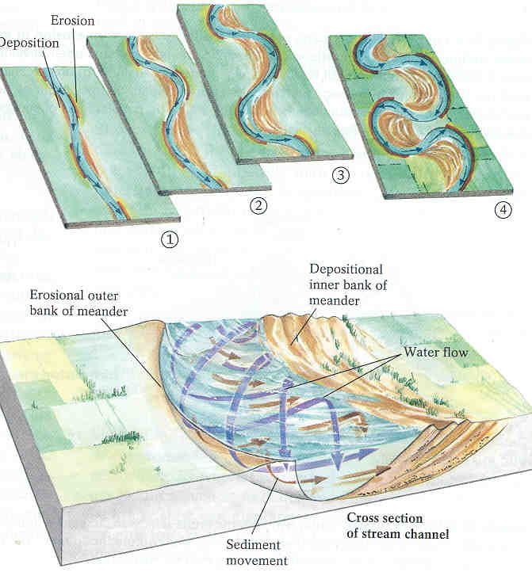

Slide 42
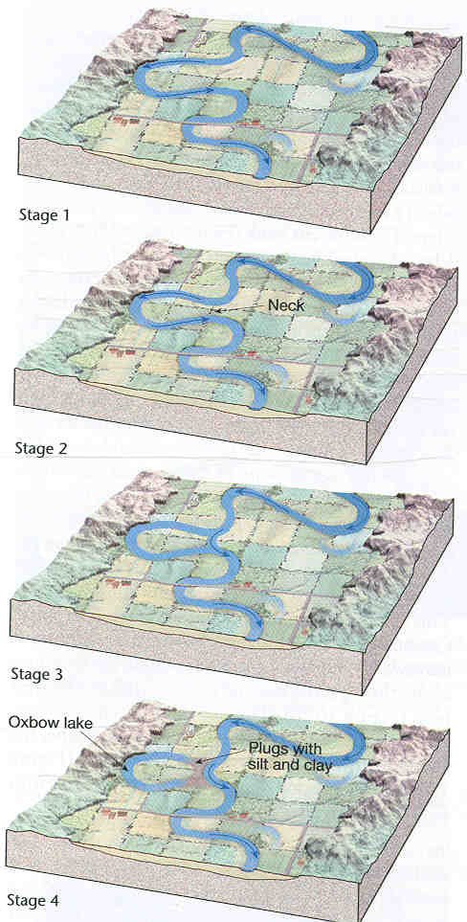
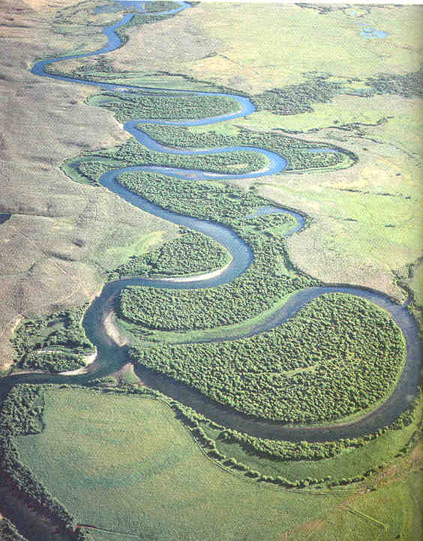

Slide 43
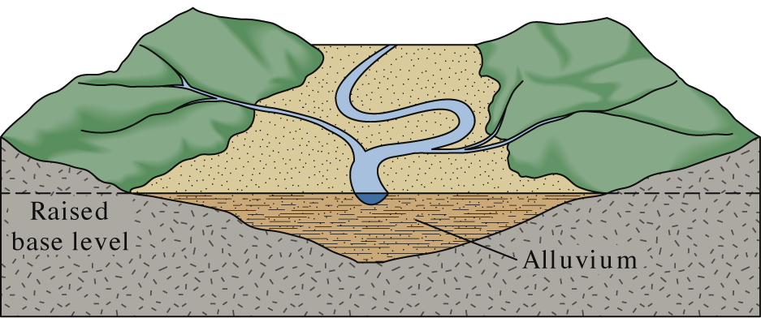
Fig. 17.21 b
Raising the base level of a stream leads
to deposition of sediments and
can induce meandering…
W. W. Norton

Slide 44
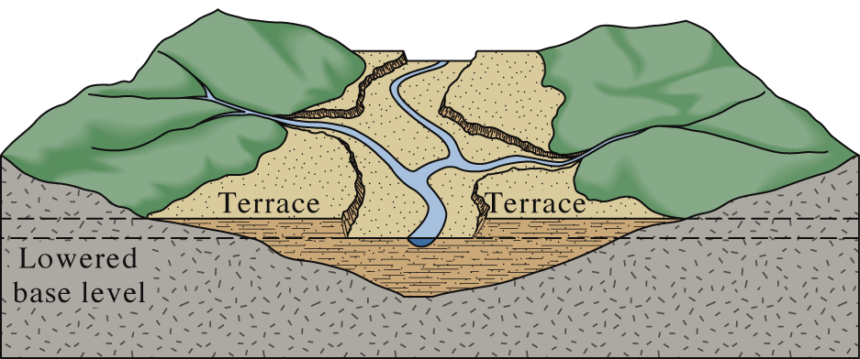
Fig. 17.21 c
Lowering base level can cause vertical erosion
and channel incision, with the formation of terraces…
W. W. Norton

Slide 45
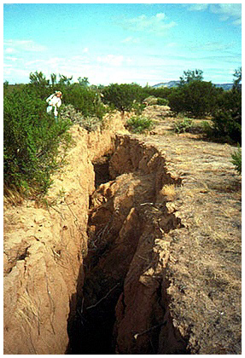
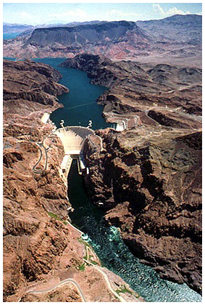
Did base level go up or down here?
What happened
to base level upstream
from the dam?

Slide 46
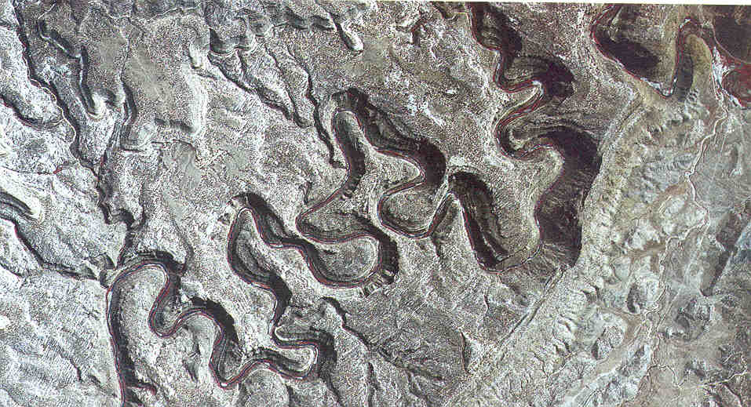
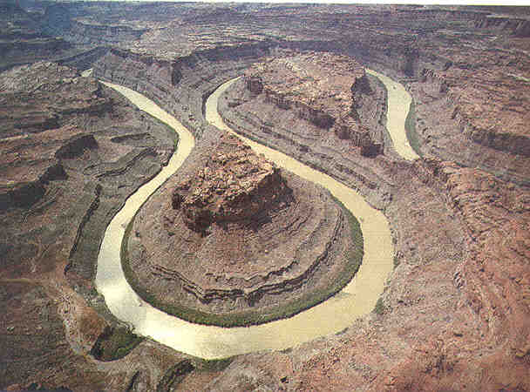
Incised
meanders
What happened to
base level here?

Slide 47
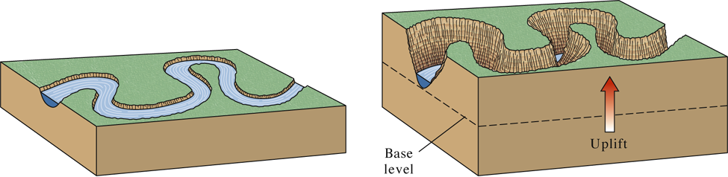
Fig. 17.10 a, b
Base level can be altered by:
Local or regional uplift
Sea level change
W. W. Norton

Slide 48

Fig. 17.27 a
Deltas form where streams
enter a lake or the ocean.
Modified from Hamblin and Christiansen, 1988
As streams enter a
standing body of water
they lose velocity and
deposit their sediment.

Slide 49

Fig. 17.27 b
The name “delta” derives from the similarity in shape of
classic deltas to the Greek letter of that name…
Modified from Hamblin and Christiansen, 1988

Slide 50

Fig. 17.27 c
Not all deltas have the classic shape. Where wave
erosion is weak, channels may build outward into
the ocean forming a “birds foot: delta, like the Mississippi.
Modified from Hamblin and Christiansen, 1988

Slide 51

RUNNING
WATER
Stream Profiles
Longitudinal Stream Profile: A cross sectional
view that shows how the slope of a stream channel
changes along its course.

Slide 52

Fig. 17.02
Sources of water that sustain stream flow….
W. W. Norton

