Slide 1
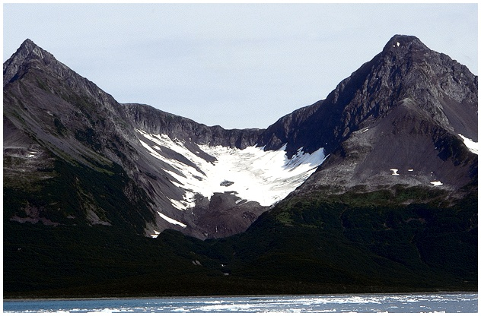

Slide 2
Shamollarning, muzlik, ko‘l va botqoqliklarning geologik faoliyati. Tog‘ jinslari, foydali qazilmalar. Yer usti relefining o‘zgarishi.

Slide 3
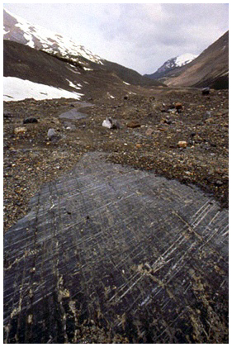
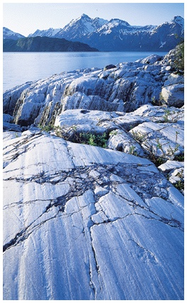

Slide 4
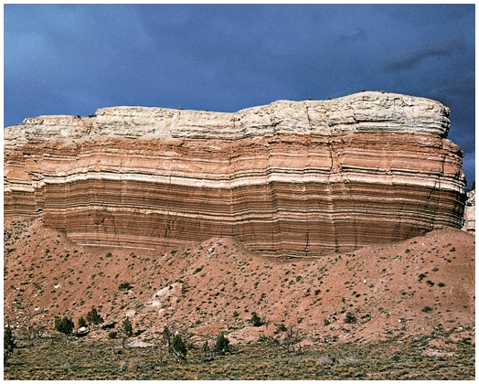
Horizontal layering
Color variation of layers

Slide 5
Reja:
1.Shamollarning, muzlik, ko‘l va 2.botqoqliklarning geologik faoliyati.
3.Tog‘ jinslari, foydali qazilmalar.
4.Yer usti relefining o‘zgarishi

Slide 6
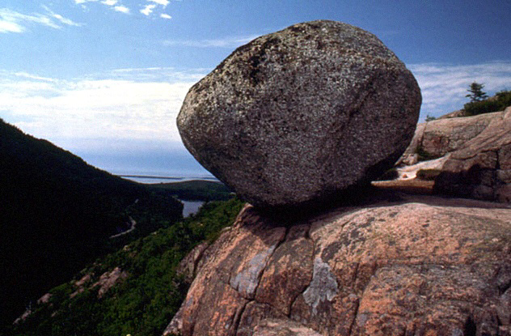
Glacial deposits…

Slide 7
BLIS SAVOL
1. Shamol nima?
2. Muzlik nima?
3. Botqoqlik nima?
4. Tog‘ jinsi nima?
5. Foydali qazilma tushunchasi.

Slide 8
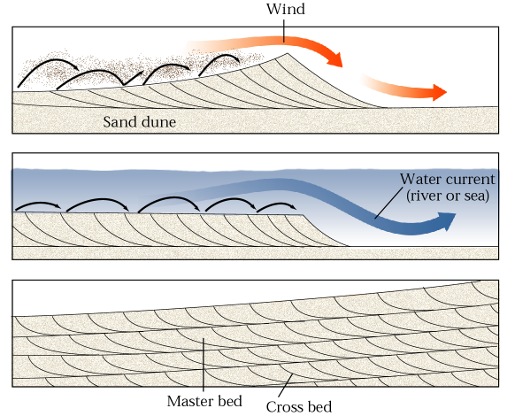
Fig. 7.25abc
W. W. Norton

Slide 9
ShAMOLNING GEOLOGIK FAOLIYaTI
Shamol geologik jarayonlarda eng katta kuch-qudratga ega bo‘lgan atmosfera faktorlaridan biri hisoblanib, uning geologik faoliyati ko‘proq sahrolarda, daraxtsiz, o‘simliksiz, dashti sahro joylarda, iqlim tez o‘zgarib turadigan geografik hududlarda ko‘zga aniq tashlanadi. Hisoblarning ko‘rsatishicha quruqlik maydonining 1/5 qismi, ya’ni sahroli va yarim sahroli maydonlar shamol ishlari natijasida yuzaga kelgan Maydalantan chaqiq jinslarni u yerdan ko‘chirish, sahrodagi qum barxanlarini yuzaga keltirish, ayrim yumshoq joylarni yalab, o‘pirib, kovlab ketish, turli-tuman shakl ko‘rinishiga ega bo‘lgan qoya toshlarni vujudga keltirish hodisalari shamolning geologik faoliyatidir. Yer yuzida doimiy yoki vaqt-vaqti bilan, ayniqsa to‘satdan esib keladigan shamol xillari mavjud.

Slide 10
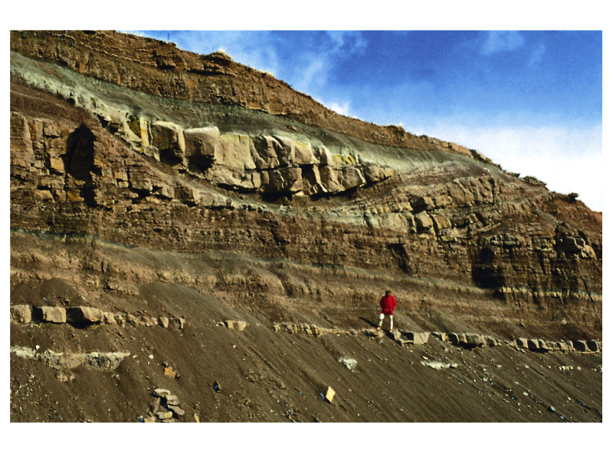
It was deposited
in a channel!

Slide 11
How does the shape of
this bed differ from
the others?
Why is this bed different?

Slide 12
MUZLIKLARNING GEOLOGIK FAOLIYATI
Muzliklarning asosiy qismi kristallangan suvdan (muzdan) va qolgan qismi firina (zichlangan yarim muz qolidagi qor uyumi)-dan iborat, hajmi katta, qor chegarasining yuqori qismida joylashgan, atmosfera yog‘ingarchiligidan hosil bo‘lgan va uzoq vaqt davomida erib ketmay harakatsiz yoki harakatda bo‘lgan jism massasidir, Antarktidadagi doimiy muzliklarning ko‘pchiligi harakatsizdir.

Slide 13
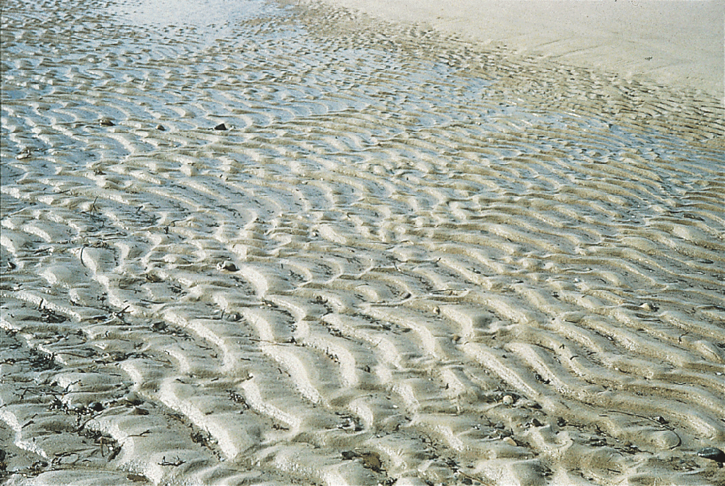
Fig. 7.27a
Stephen Marshak
Natijada to'lqin belgilari bo'lishi ham simmetrik
(to'lqinlar orqali hosil mumkin)
Oldinga va orqaga sloshing yoki simmetrik (suv hosil
yoki shamol) bir yo'nalishda oqib.

Slide 14
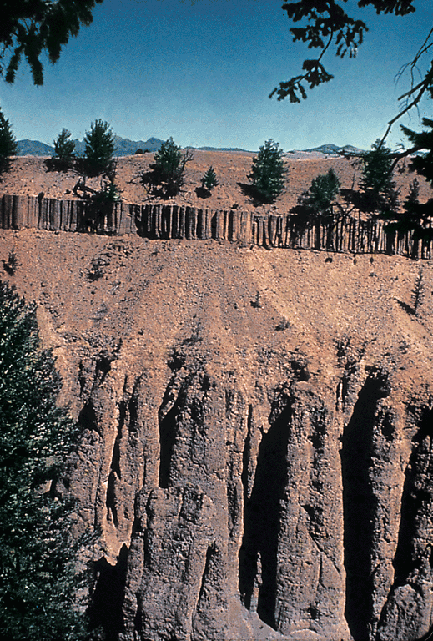
Fig. 6.08b
Stephen Marshak

Slide 15
KO‘L VA BOTQOQLIKLARNING GEOLOGIK FAOLIYATI
Atrofi quruqlik bilan o‘ralgan, dengiz bilan bevosita aloqasi yo‘q suv to‘lgan chuqur havzalarga ko‘l deyiladi. Ko‘l suvlarining ayrimlari tashqi muhitga oz miqdorda oqib turadi, lekin ko‘pchilik ko‘llarning suvi. Turg`un holida turadi. Ko`llarning genetik xillari. Ko‘llar turli xil geologik jarayonlar natijasida vujudga kelgan. Ko‘llar vujudga kelishiga qarab tektonik, denudatsion, erozion, to‘g‘on, sun’iy (inson qo‘li bilan yuzaga keltirilayotgan suv omborlari) va boshqa ko‘llarga bo‘linadi.

Slide 16
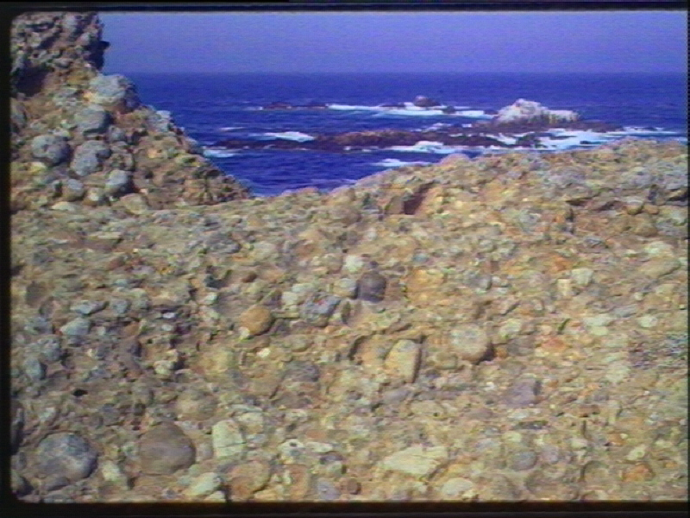
Sedimentary Rocks and the Rock Cycle
Older sedimentary rocks
(conglomerate)
being recycled into
new sediments

Slide 17
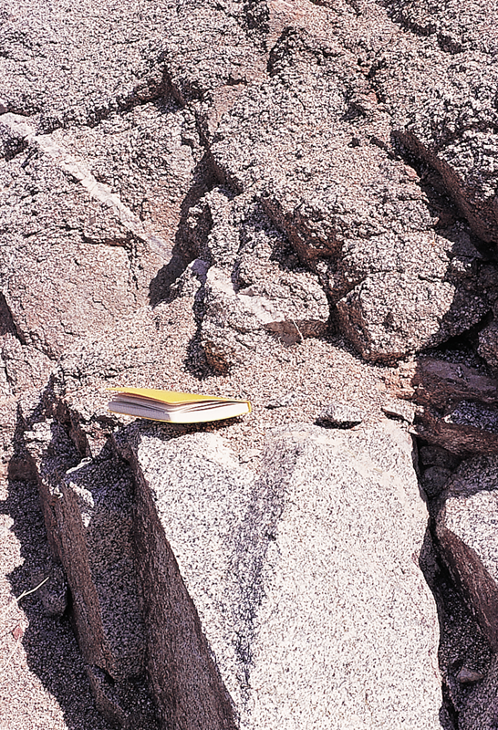
Fig. 7.03
Weathered
granite

Slide 18
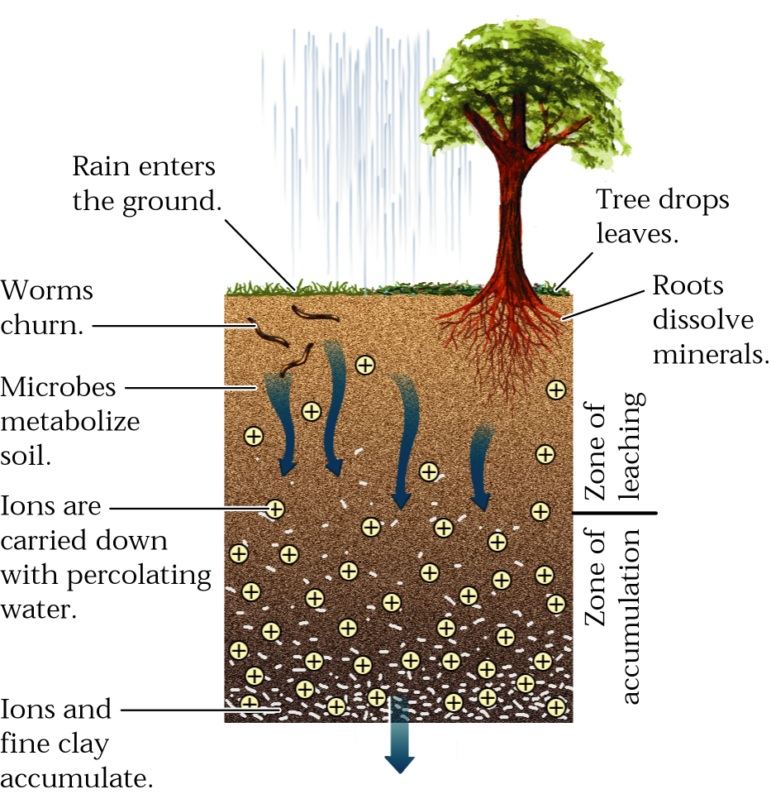
Fig. 7.11b
Soils
W. W. Norton

Slide 19
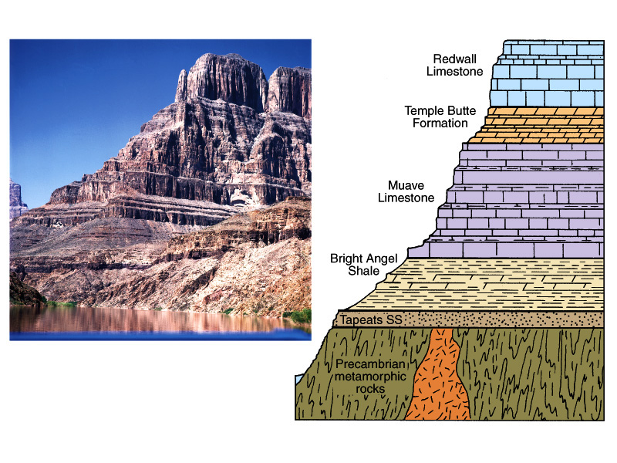
Classic example of layered
sedimentary rocks: Grand
Canyon of Arizona

Slide 20
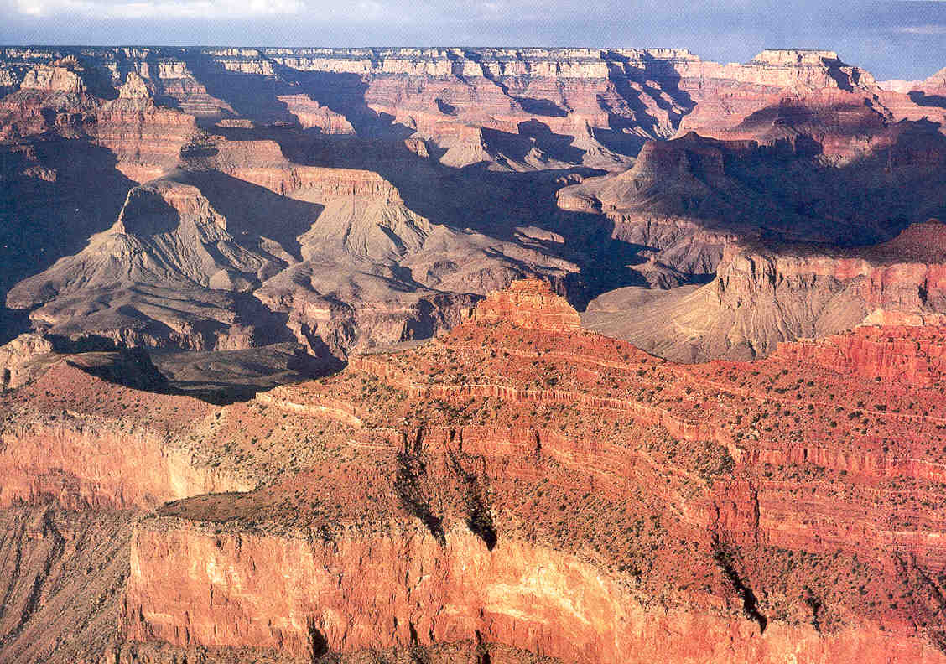

Slide 21
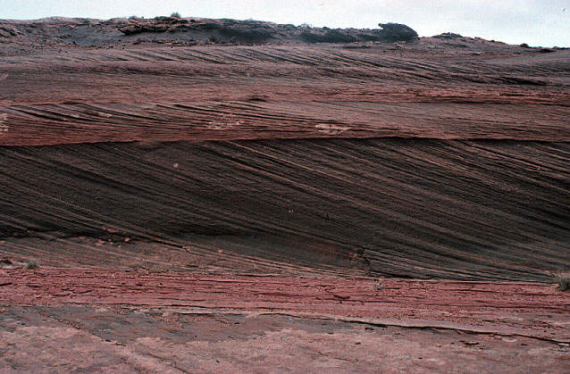
More cross-bedding
Cross beds
Bed contacts”

Slide 22
Cross-bedding
Transport direction
Tilt-direction of cross beds indicates the
direction of transport (e.g., wind direction or
direction of water flow).

Slide 23
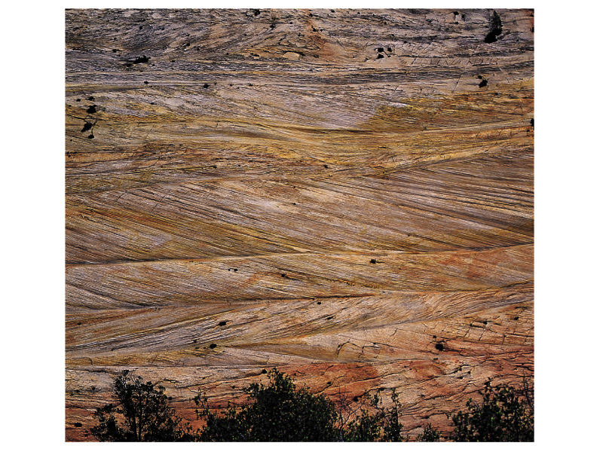
What a geologist sees.
Which way did the wind blow?

Slide 24
What a geologist sees.
Paleowinds

Slide 25
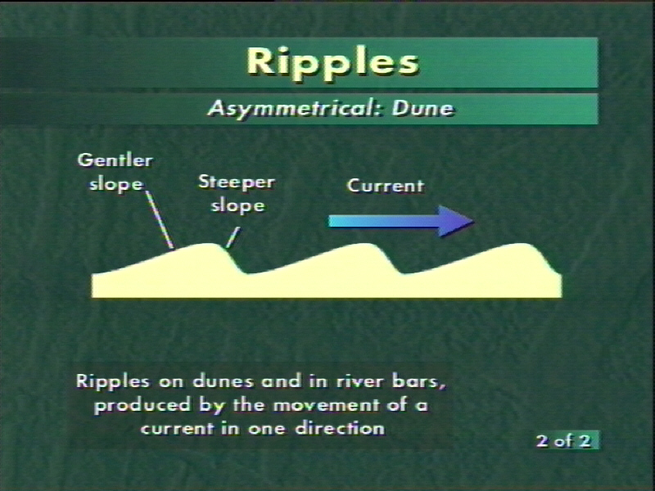

Slide 26
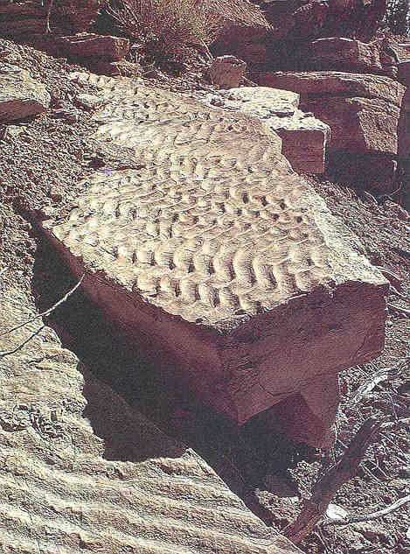

Slide 27
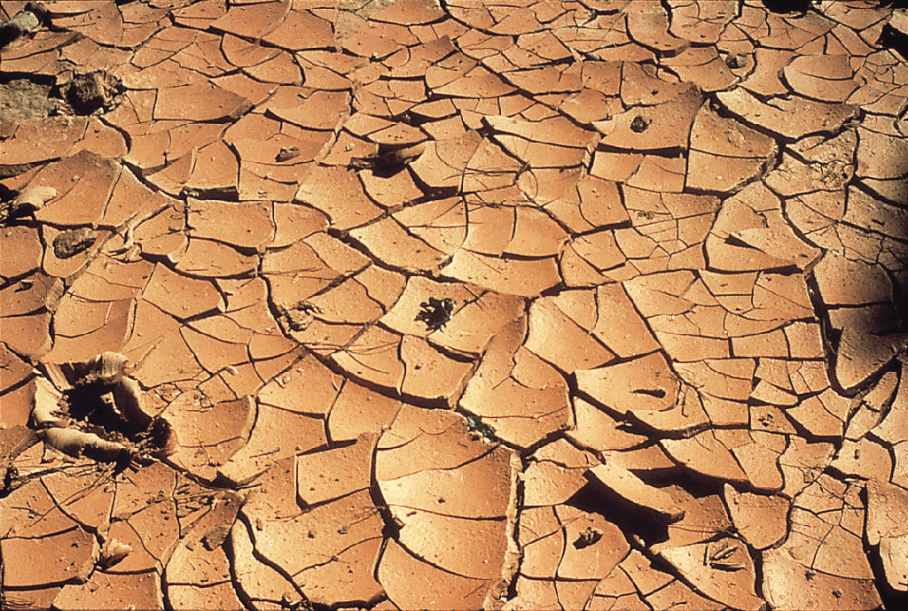
Taqirlar

Slide 28
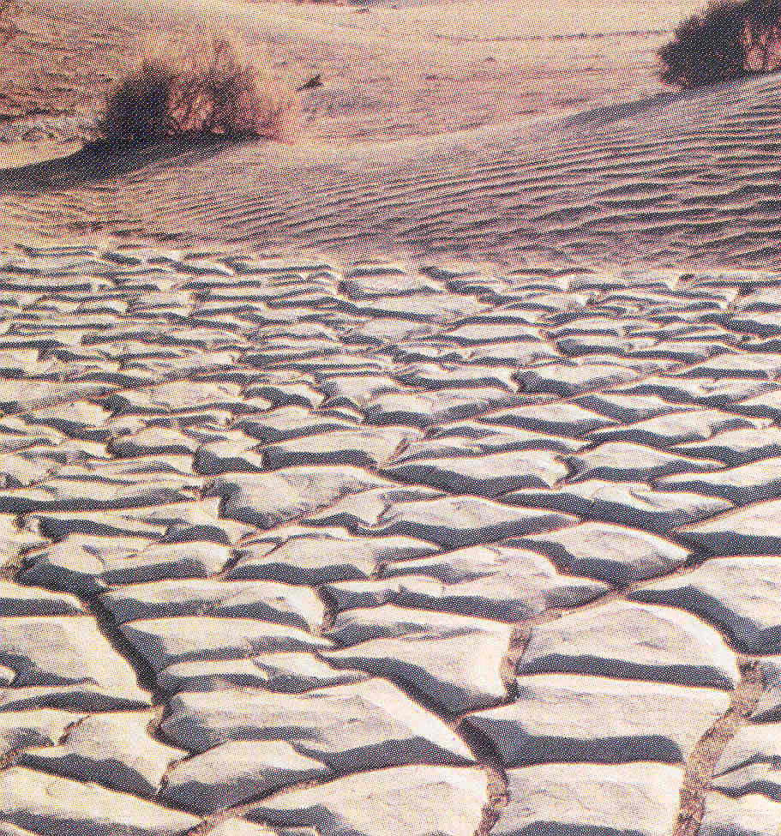
Taqirlar
Margin of a dry lake
with mud cracks.
Note ripple-marked
sand dunes at top
of picture.

Slide 29
Sedimentary Structures
Note ripple-marked
sand dunes
at top
of picture.

Slide 30
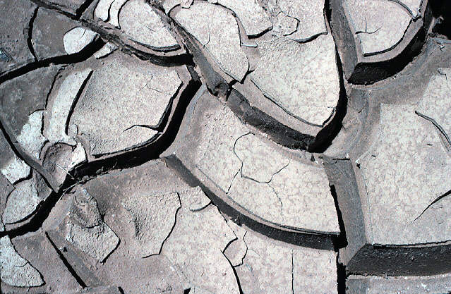
Sedimentary structures: Mud Cracks

Slide 31
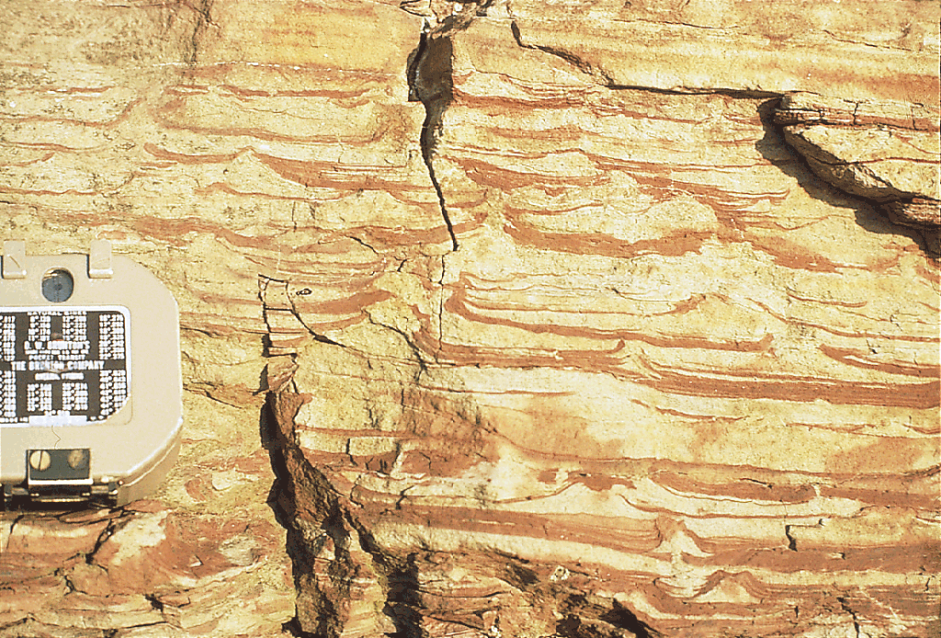
Fig. 7.27c
Say you find mud cracks in
an ancient sedimentary rock.
What does that suggest about the
environment where the rock formed?
Stephen Marhsak

Slide 32
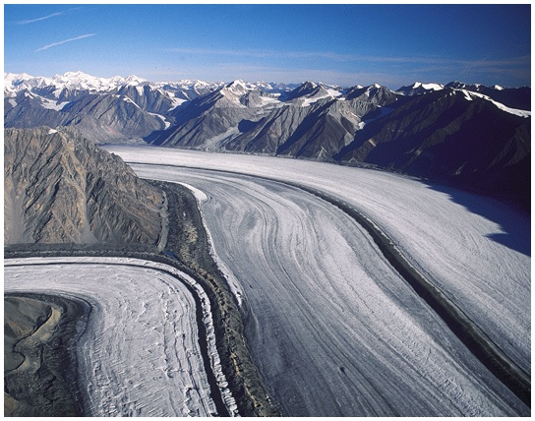

Slide 33
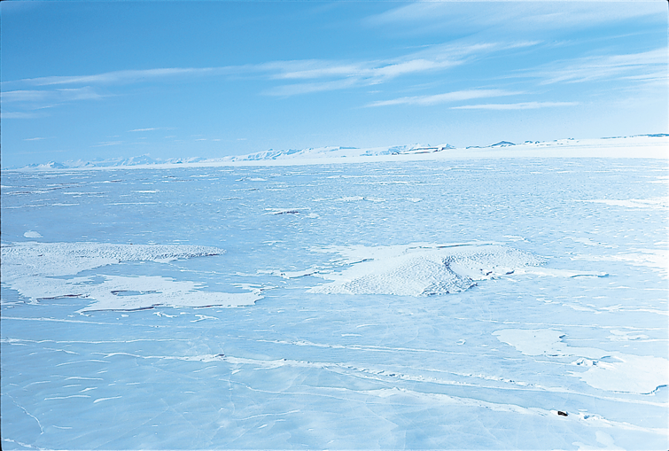
Fig. 22.01 b
Stephen Marshak
Glaciers form where more snow accumulates
in winter than melts in the summer.

Slide 34
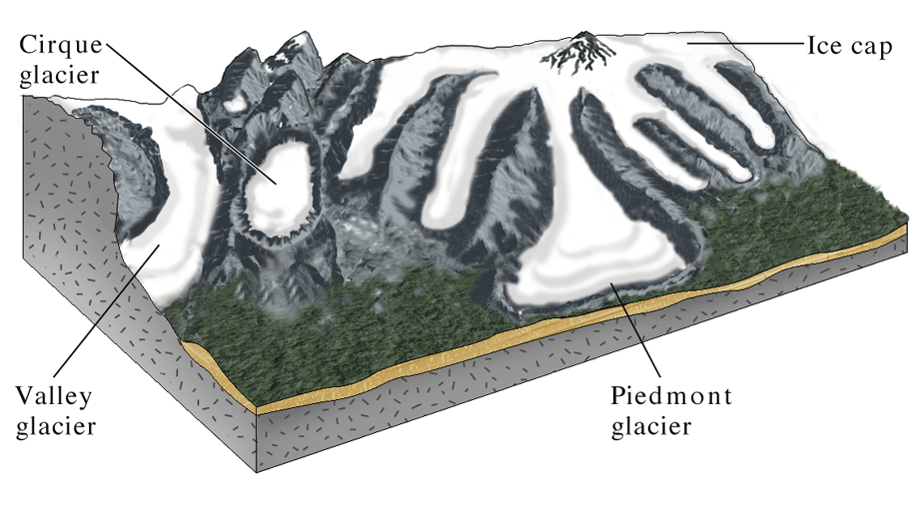
Fig. 22.04 a
Types of glaciers…
W. W. Norton

Slide 35
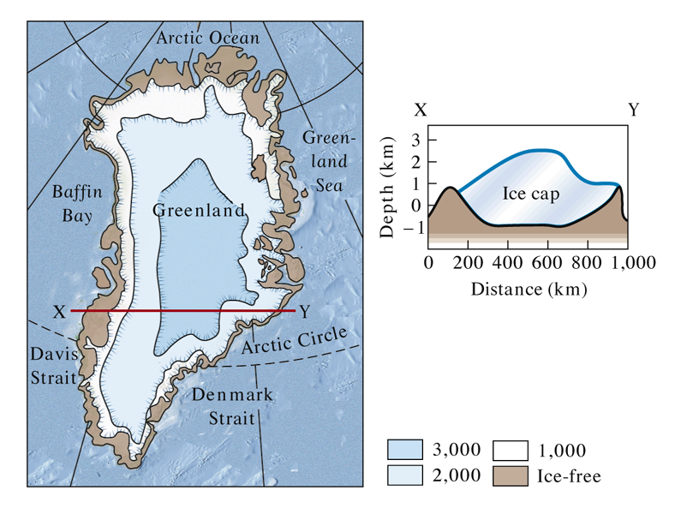
Fig. 22.05 a
The Greenland ice cap…
W. W. Norton. Modified from Flint, 1971

Slide 36
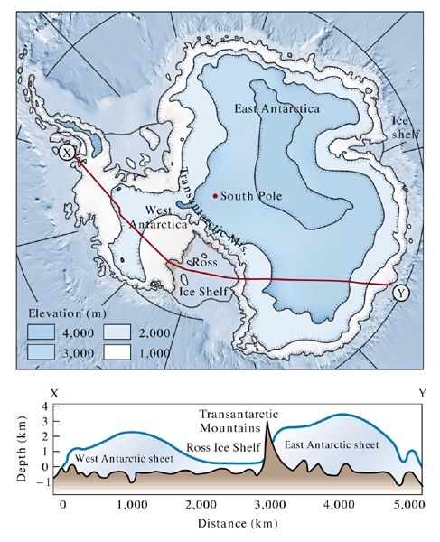
Fig. 22.05 b
The Antarctic ice cap…

Slide 37
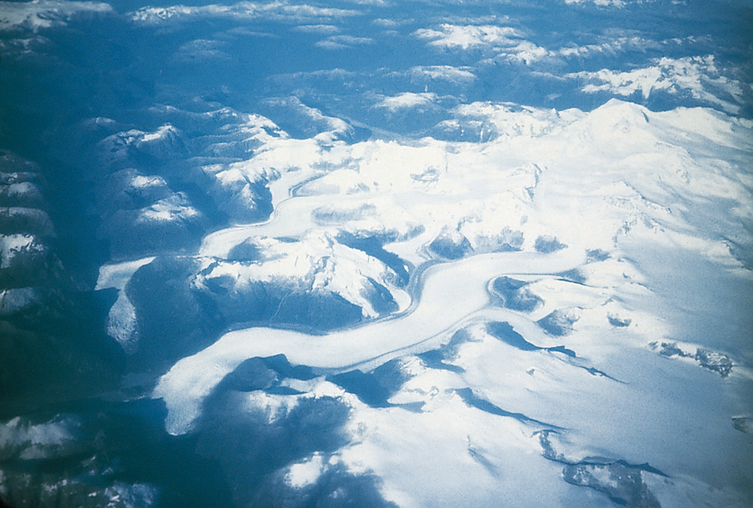
Fig. 22.04 c
Stephen Marshak

Slide 38
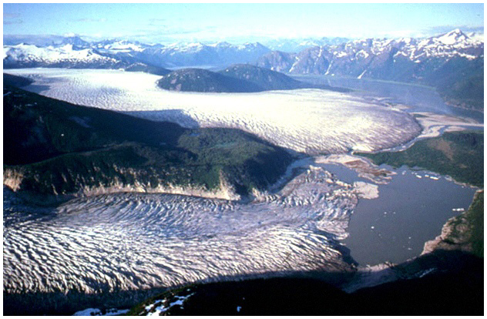

Slide 39
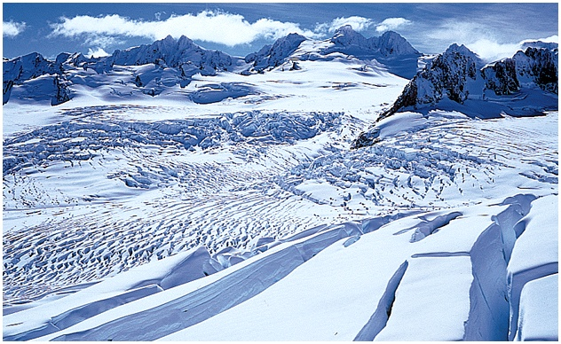

Slide 40
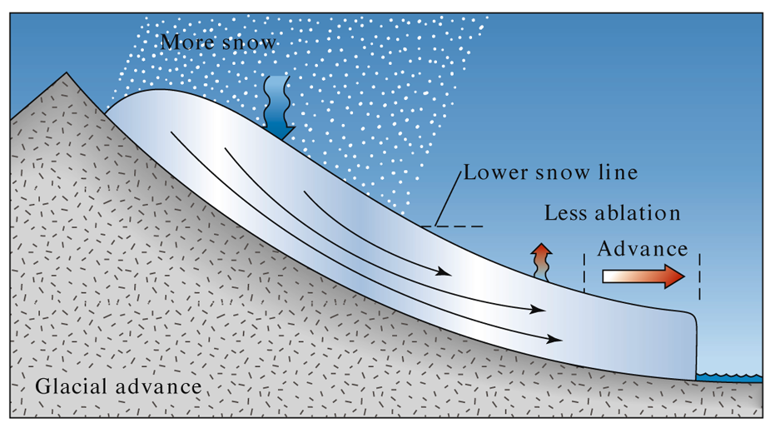
Fig. 22.13 b
W. W. Norton

Slide 41
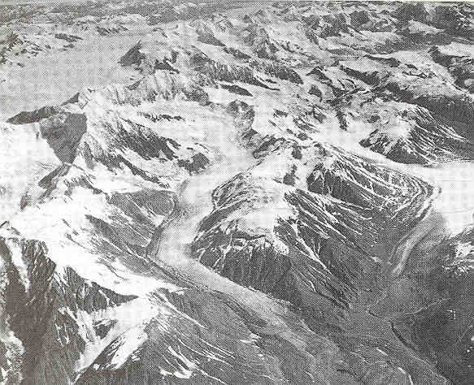
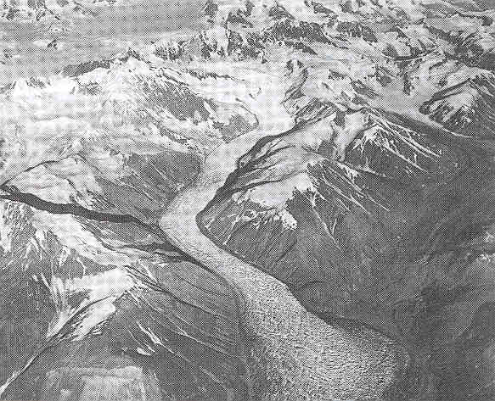
Short term
glacial
advances…
or “surges”
Two decades later…

Slide 42
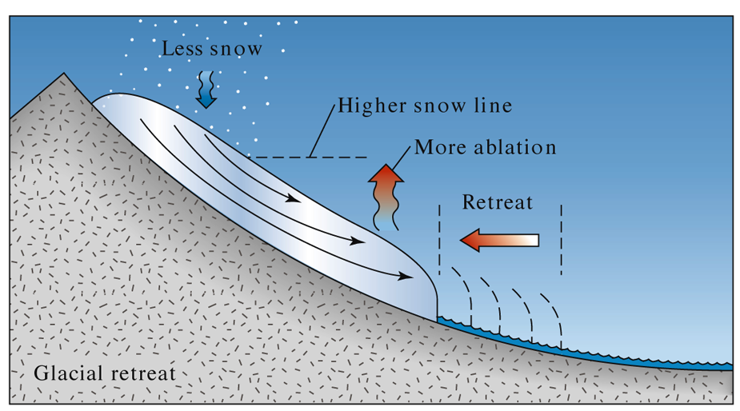
Fig. 22.13 c
W. W. Norton

Slide 43
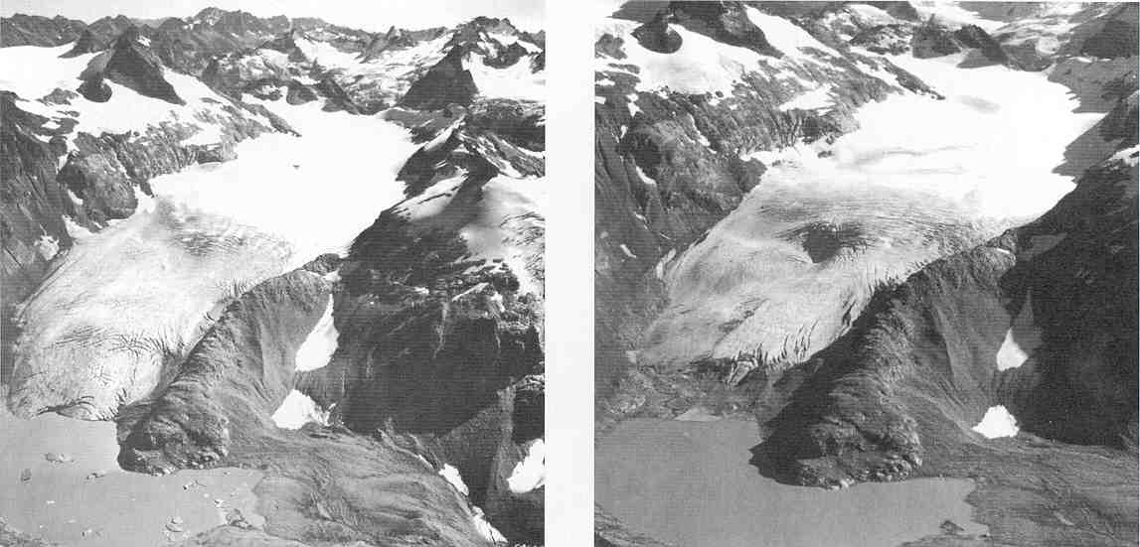
Short-term glacial retreat…
….23 years later

Slide 44
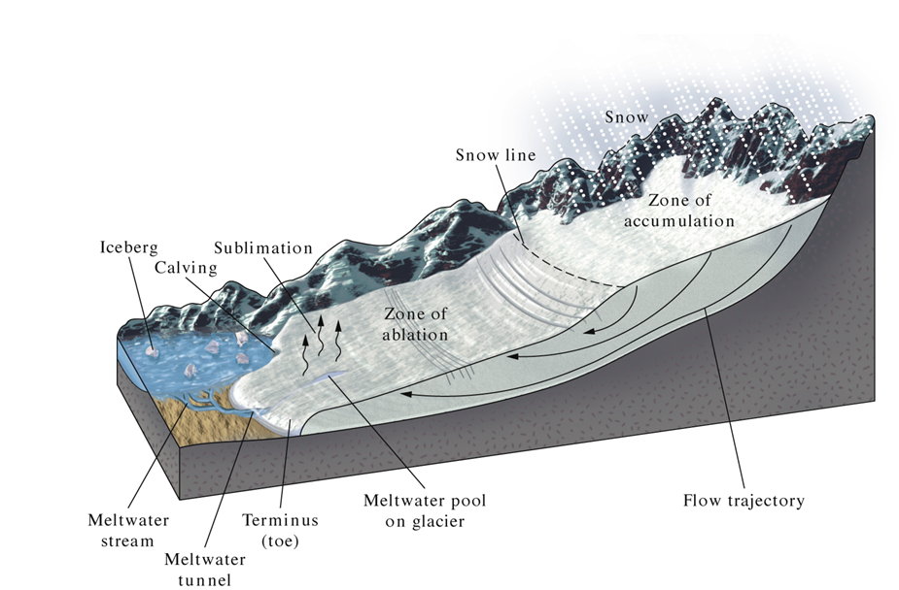
Fig. 22.12
W. W. Norton

Slide 45
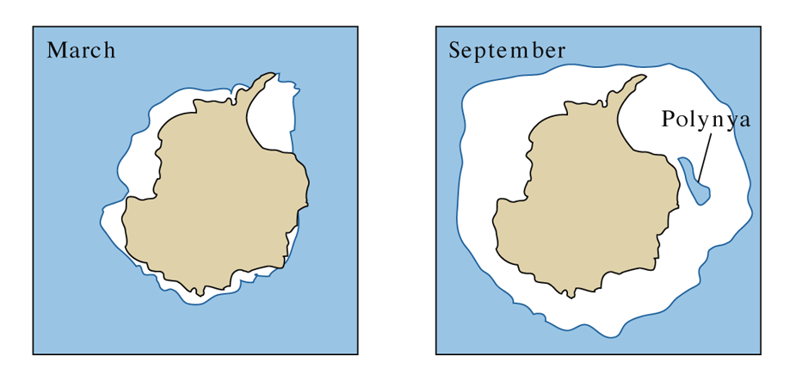
Fig. 22.15 b
The Antarctic ice cap advances and
retreats on a seasonal basis…
W. W. Norton. Modified from Skinner and Porter, 1995

Slide 46
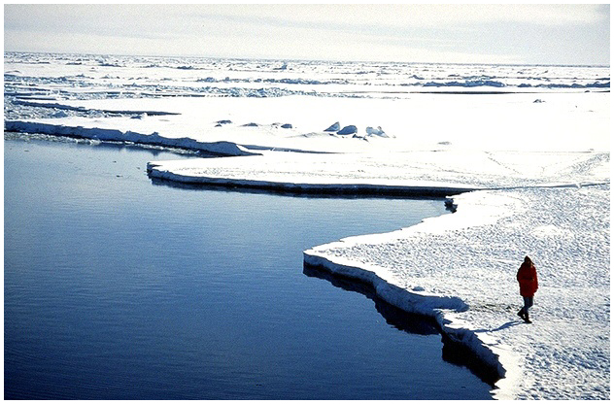

Slide 47
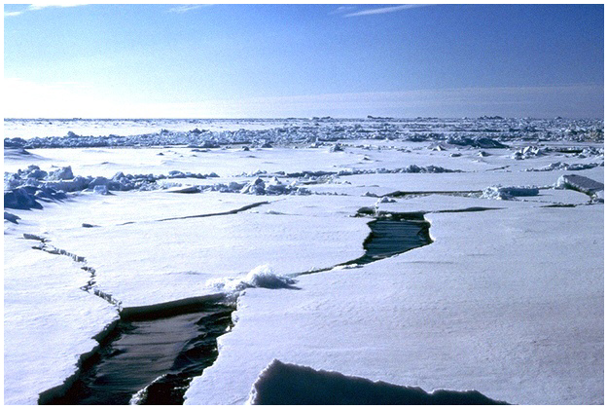

Slide 48
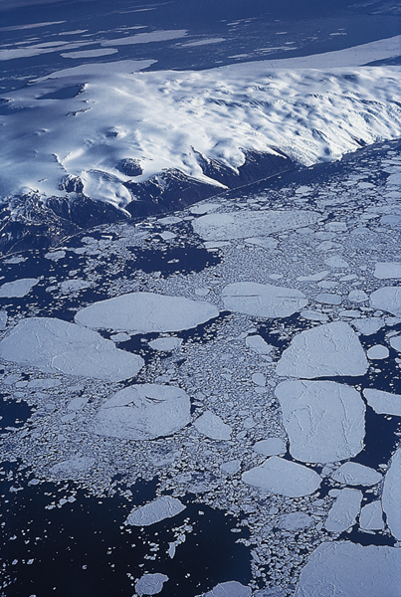
Fig. 22.15 d
Stephen Marshak

Slide 49
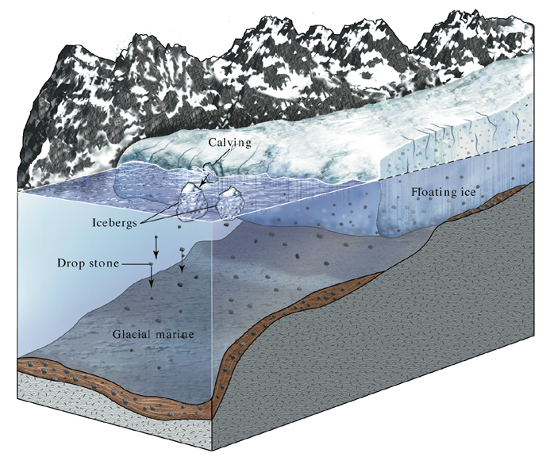
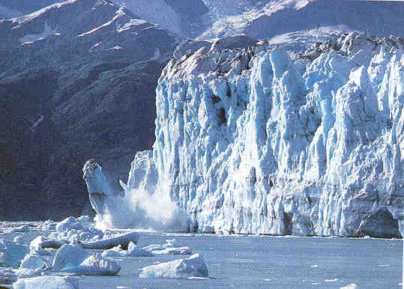
Fig. 22.15 a
Glacial retreat by calving at terminus…
W. W. Norton

Slide 50
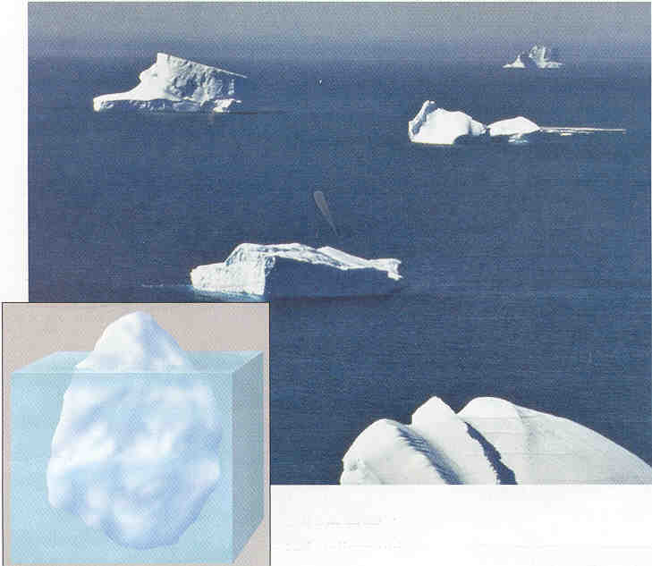

Slide 51
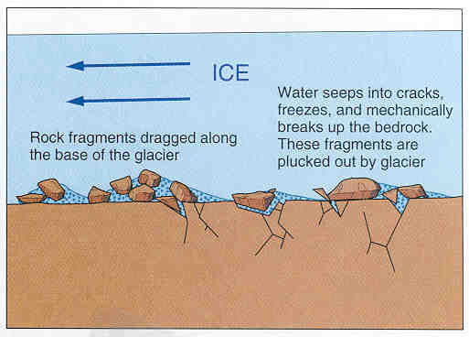
Glacial erosion
“Plucking” - glacier loosens/lifts/incorporates
fractured rock by the melting and
freezing of ice in bedrock fractures.

Slide 52
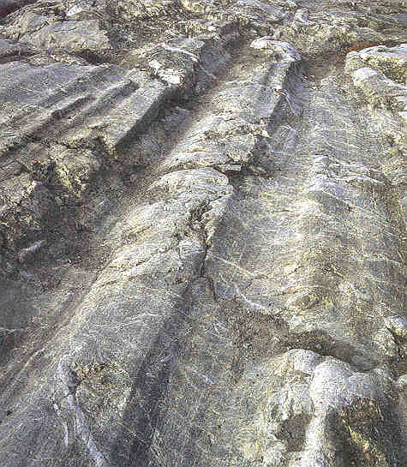
Glacial erosion
2 ways:
Plucking - glacier loosens/lifts/incorporates fractured rock
Abrasion - Glacier+rock fragments scrape over bedrock
(like sandpaper), make rock flour
glacial striations
Indicate direction of flow

Slide 53
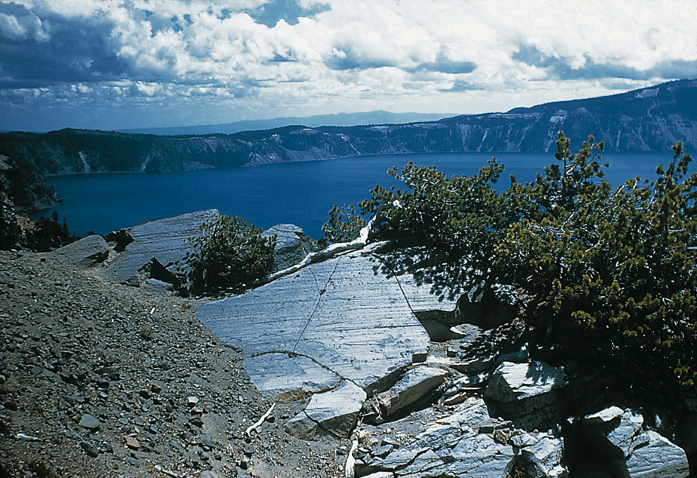
Fig. 22.17 d
Stephen Marshak

Slide 54
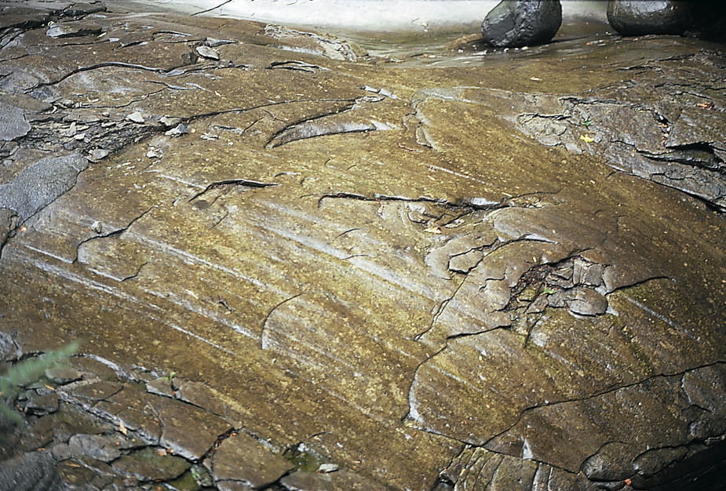
Fig. 22.17 c
Stephen Marshak

Slide 55
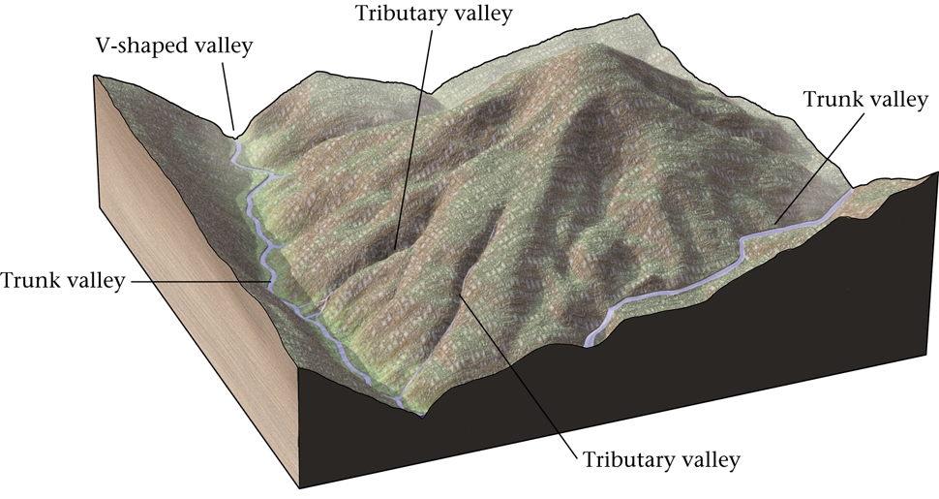
Fig. 22.18 a
Begin with a young river valley system…
W. W. Norton

Slide 56
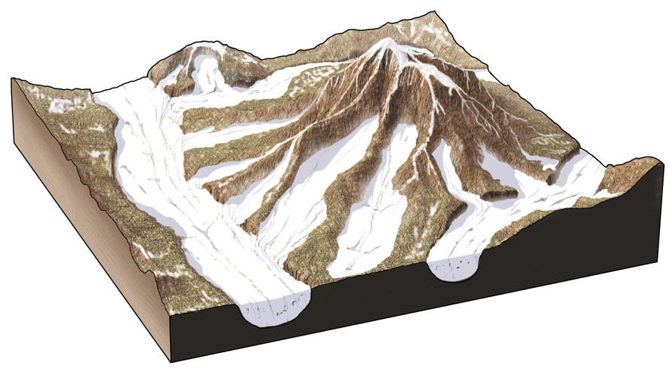
Fig. 22.18 b
Global climate change leads to glaciation...
W. W. Norton

Slide 57
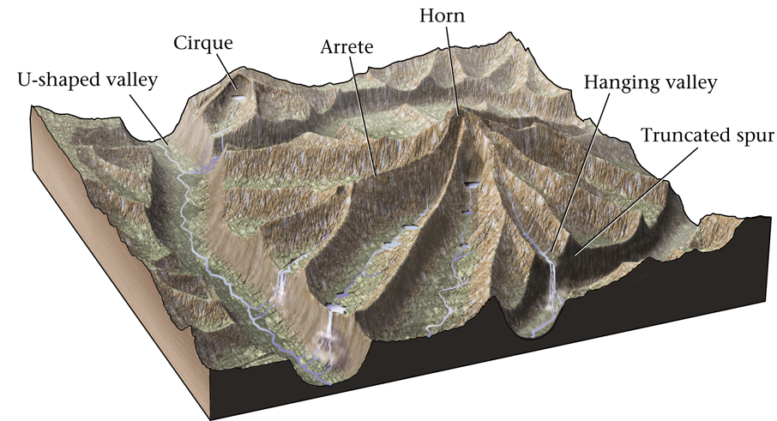
Fig. 22.18 c
Erosional landforms left behind by glaciers…
W. W. Norton

Slide 58

Glacially-eroded landforms
U-shaped valleys…

Slide 59

Fig. 22.20
Fjords: Drowned glacial
valleys that were formed in
high latitude coastal areas
following the sea level rise
at the end of the last glaciation.
Stephen Marshak

Slide 60

Glacially-eroded landforms
Cirques…
Bowl-shaped
depressions
carved by ice.

Slide 61

Glacially-eroded landforms
Tarns…
Lakes in bowl-
shaped basins,
(cirques) along
a glacial valley…

Slide 62

Fig. 22.17 b
Roche Moutonnees…
W. W. Norton
Eroded hills of bedrock lying on the floor of a
glacial valley. Steep slope on downstream side.

Slide 63

Forming truncated spurs
and handing valleys…

Slide 64

Truncated spurs…Yosemite Valley

Slide 65

Glacially-eroded landforms
Hanging Valleys…
Bridalveil Falls
Yosemite, CA

Slide 66

Glacially-eroded landforms
Aretes:
Sharp-edged ridges separating glacial valleys…
What is this
feature called?

Slide 67

Glacially-eroded landforms
Horns…
Sharp-peaked
mountains
formed by cirque
enlargement
from opposing
directions.
Matterhorn

Slide 68

Cross-bedding is internal bedding that is tilted at an angle to the primary bedding. Cross beds are formed by a scour and fill transport process involving either wind or water (see
ripple movie).
Cross-to'shak, asosiy to'shashdan burchak ostida qiya ichki to'shamalar hisoblanadi. Cross To'shak bir oyulma tomonidan tashkil va shamol yoki suv yo jalb transport jarayonini to'ldirish etiladi (qarang
ripple kino).

Slide 69


Slide 70

Fig. 7.10c
Stephen Marshak
Spheroidal weathering of granite

