Slide 1
6-Mavzu: Roll, Lagranj teoremalari

Slide 2


Slide 3



Slide 4
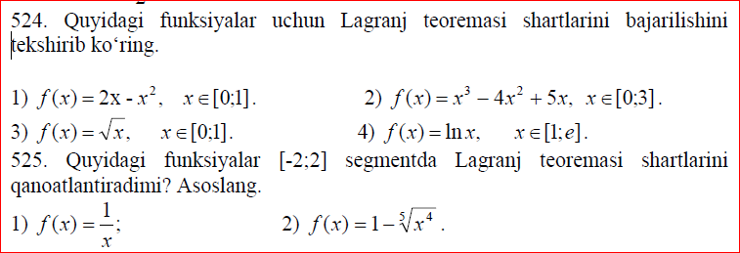


Slide 5


