Slide 1
Aniq integral tushunchasiga olib keladigan masalalar

Slide 3
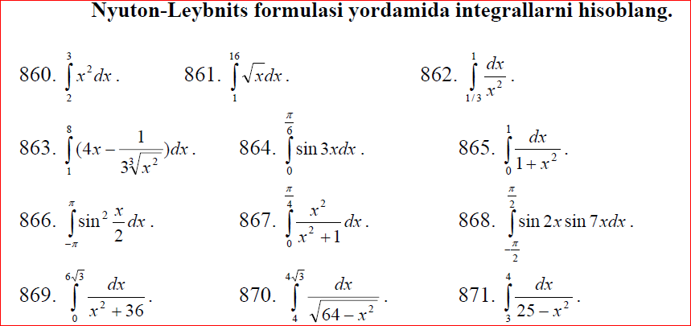

Slide 4
