Slide 1

Notes:
Sources of images: google images and rrrather.com

Slide 2


Would you rather…
…be able to fly or be invisible?
Notes:
rrrather.com

Slide 3


Would you rather…
…be talented at all musical instruments…
…or be talented at all sports?
Notes:
rrrather.com

Slide 4


Would you rather…
…forget who you are…
…. or forget who everyone else is?
Notes:
rrrather.com

Slide 5

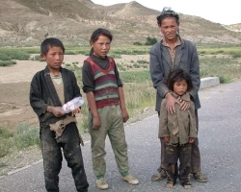
If you won $1 billion, would you rather…
…keep it all and share none of it…
…or give it to people who don’t have much?
Notes:
rrrather.com

Slide 6
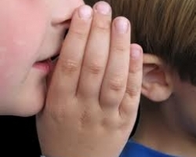

Would you rather…
…only be able to whisper…or only be able to shout?
Notes:
rrrather.com

Slide 7
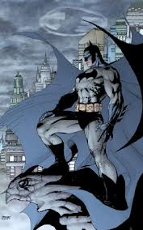
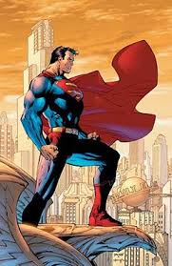
Would you rather…
… be batman… …or be superman?
Notes:
rrrather.com

Slide 8
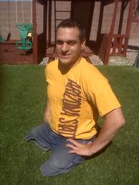
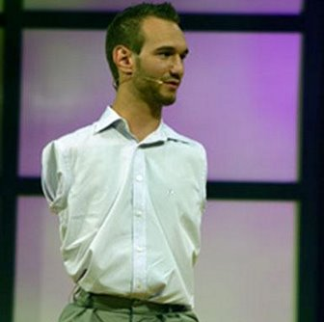
Would you rather…
…have no arms…. …or no legs?
Notes:
rrrather.com

Slide 9

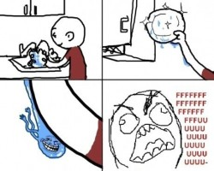
Would you rather…
…do the laundry…
…or the dishes?
Notes:
rrrather.com

Slide 10
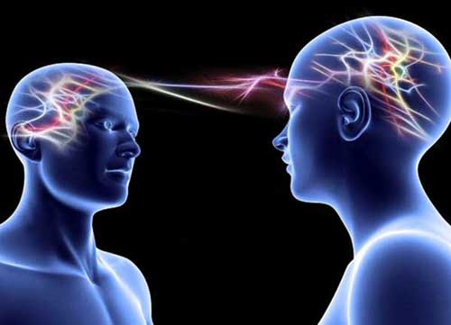

Would you rather…
…be telepathic ….. or be psychokinetic?
Notes:
rrrather.com

Slide 11
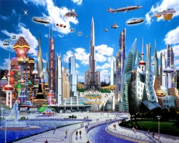
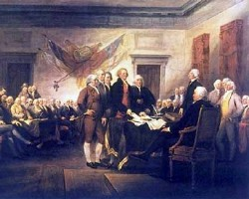
Would you rather…
…meet your great grandchildren…
…or your ancestors?
Notes:
rrrather.com

Slide 12

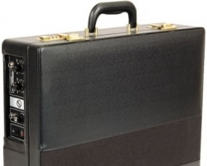
Would you rather…
… have a cup that has a never-ending drink (of your choice)
… or have a briefcase that can change into any machine of your choice?
Notes:
rrrather.com

Slide 13


Would you rather…
… be able to end all hunger and disease…
… or be able to make world peace happen forever?
Notes:
rrrather.com

Slide 14


Would you rather…
…follow your dreams, work hard, and achieve your dreams later in life…
…or would you rather get rich now?
Notes:
rrrather.com

Slide 15
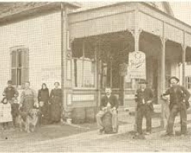
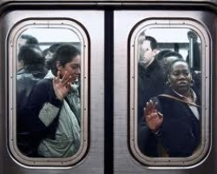
Would you rather…
…live in a simpler time without electricity, plumbing, medicine…
… or live in a polluted, crowded future without disease or hunger?
Notes:
rrrather.com

Slide 16

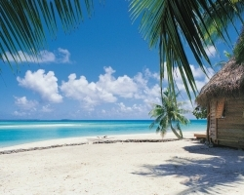
Would you rather live where it is …
…winter every day of your life...
…or summer everyday of your life?
Notes:
rrrather.com

Slide 17
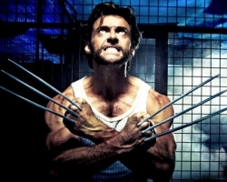
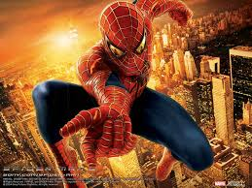
Would you rather…
…be wolverine or be spider-man?
Notes:
http://www.rrrather.com/48

